Slide 1
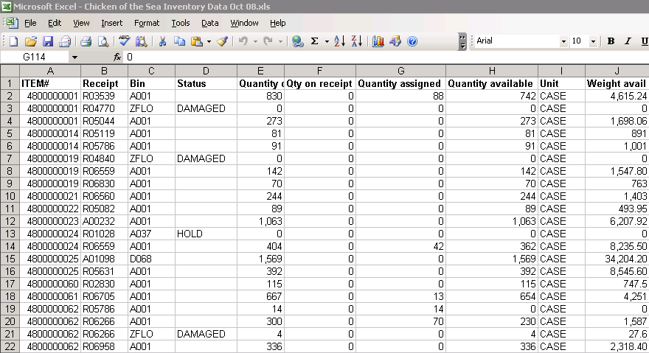
Warehouse Profiling
Chapter 2

Slide 2
Activity Profiling
Systematic analysis of item and order activity
Used to quickly identify root causes of material and information flow problems
Pinpoint major opportunities for process improvements
Provide an objective basis for project-team decision making.

Slide 3
Profiling Motivations and Minefields
Profiling Pays
Drown in a shallow lake – “on average”
Data stimulates creative thinking
A picture is worth 1,000 words
Paralysis by analysis

Slide 4
Key Profiling Facts
What is the business? Who are the customers? What are the service requirements? What special handling is required?
The area of the warehouse and types of storage, material handling equipment
Average number of SKUs in the warehouse
Average number of pick-lines shipped per day
Average number of units per pick-line
Average number of customer orders shipped in a day
Number of order-pickers and how many shifts devoted to pallet movement, to case-picking, and to broken case picking
Average number of shipments received in a day
Average rate of introduction of new SKUs
Seasonalities

Slide 5
Useful sku information to gather
Useful information to gather about each sku
A Unique ID
A brief text description
Which product family the skuis assigned to
Addresses of storage locations within the warehouse
For each location the skuis stored:
Scale of the storage unit (i.e. pallet or case)
Dimensions of the storage unit
Scale of the selling unit (i.e. cases or pieces)
Number of selling units per storage unit
Date introduced
Maximum inventory levels by month or week

Slide 6
SKU Data
It is important to understand the different types of storage units and selling units within a warehouse.
Example:
“Case” is often referred to by other names such as “carton” or “box”. Depending on its use, it can have substantially different meanings for a warehouse.
A vendor may ship a case that contains several inner packs each of which contains several boxes, each of which contains pieces.
Take a ballpoint pen …
The manufacturer may supply the product 12 pieces to a box, 12 boxes to an inner pack (stored in a thin carton container), and 4 inner packs to a case for a grand total of 576 pens in the vendor’s case or shipping unit.
Thus, understanding how the packing data is stored within the database is critical to successful warehouse operations. If the customer is required to purchase boxes, the selling unit may be listed as “12” or “box”. Now suppose the database records a customer purchase of 12 which appears on the order-picker’s ticket. Knowing if 12 means each or boxes is critical to picking the correct quantity and providing an accurate customer order.

Slide 7
Warehouse Design Considerations
General considerations
Quantity and character of goods must be known—product profiling
Know the purpose to be served
Storage
Distribution
Cross-docking

Slide 8
Warehouse Design Considerations
Trade-offs
Fixed versus variable slot locations for merchandise
Build out (horizontal) versus build up (vertical)
Order-picking versus stock-replenishing functions
Two-dock versus single-dock layout
Conventional, narrow, or very narrow aisles
Paperless warehousing vs. traditional paper-oriented warehousing operations
Other space needs

Slide 9
Public Warehouses
Public warehouses
Serve all legitimate users
Require no capital investment on the user’s part
Allows users to rent space as needed
Can be rented on a month-to-month basis
Offers more locational flexibility
May provide specialized services
Potential drawback of public warehouses
Lack of control by the user
Warehousing labor safety practices monitored by Occupational Safety and Health Administration (OSHA)

Slide 10
Private Warehouses
Private warehousing
is owned or occupied on a long-term lease
Offers control to owner
Assumes both sufficient demand volume and stability so that warehouse remains full
Potential drawbacks of private warehouses include:
High fixed cost
Necessity of having high and steady demand volumes
May reduce an organization’s flexibility

Slide 11
Warehouse Design Issues and related Profiles
Planning & Design | Key Questions | Required Profile | Profile Components
Order picking and shipment process design | Order batch size Pick wave planning Picking tour construction Shipping mode disposition | Customer Order Profile | Order Mix Lines per order Lines and cube per order
Receiving & Putaway process design | Receiving mode disposition Putaway batch size Putaway tour construction | Purchase Order Profile | Order mix distributions Lines per receipt Lines and cube per receipt
Slotting | Zone definition Storage mode selection and sizing Pick face sizing Item location assignment | Item Activity Profile | Popularity Cube-movement/volume Popularity-volume Order completion Demand correlation Demand variable
Material Transport Systems Engineering | Material handling systems selection and sizing | Calendar-clock Profile | Seasonality profile Daily activity profile
Warehouse layout and material flow | Overall warehouse flow design: U, S, I, or L Relative functional locations Building configuration | Activity relationship Profile | Activity relationship distribution
Warehouse Sizing | Overall warehouse space requirements | Inventory Profile | Item family inventory distribution Handling unit inventory distribution
Level of automation and staffing | Staffing requirements Capital-labor substitution Level of mechanization

Slide 12
Customer Order Profiling
Warehouse in a warehouse
Customer order profile
Order mix distributions
Lines per order distribution
Cube per order distribution
Lines and cube per order distribution

Slide 13
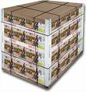
Order Mix Distributions
Family Mix Distribution
Handling Unit Mix Distributions
Full/partial pallet mix
Full/broken case mix
Order Increment distributions

Slide 14
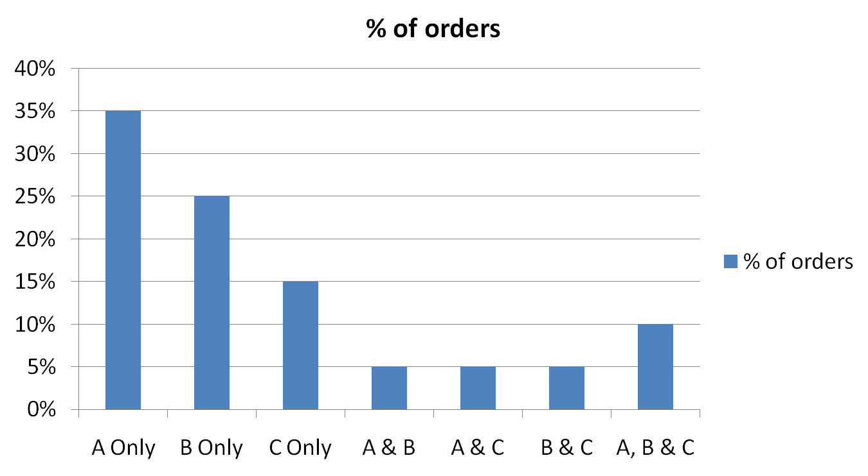
Family Mix Distribution

Slide 15
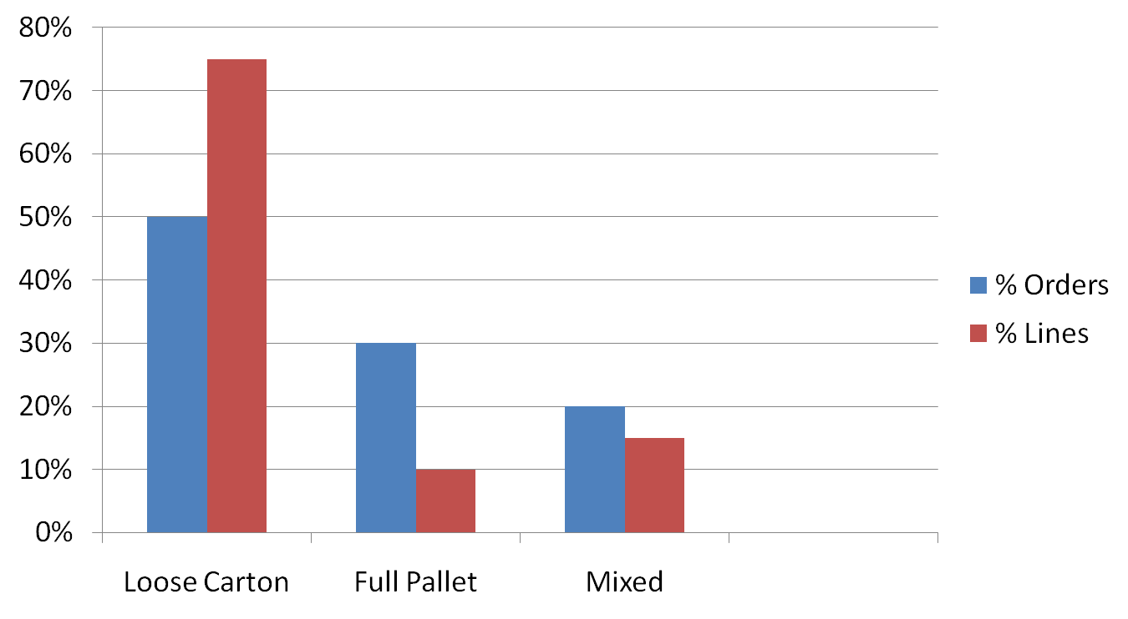
Full/Partial Pallet Mix

Slide 16
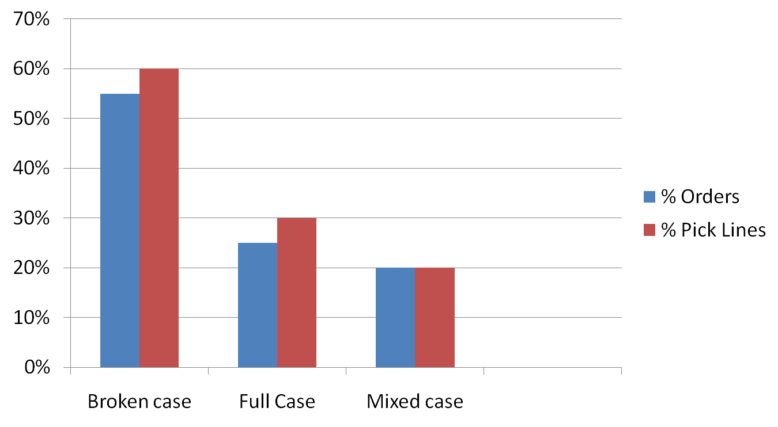
Full/Broken Case Mix

Slide 17
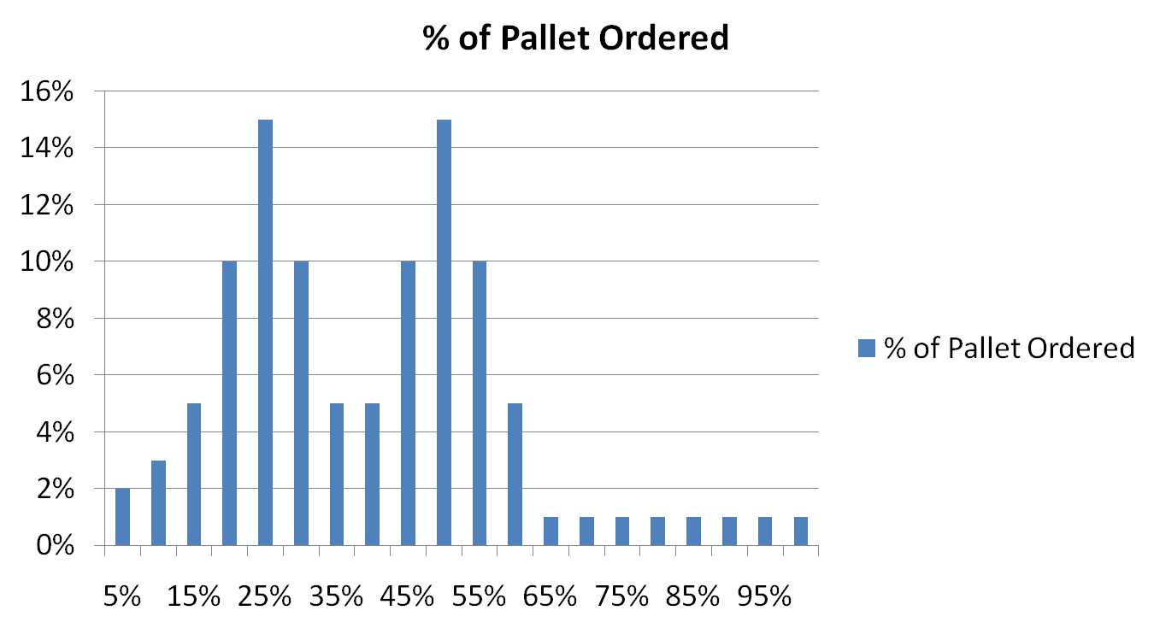
Pallet Order Increment

Slide 18
Line Per Order Distribution
70%
60%
50%
40%
30%
20%
10%
Full Case
Broken Case
Overall
Backorders
Emergency Orders
Fast Pick-pack
1 2 3-5 6-9 10+

Slide 19
Lines and Cube per Order Distribution
Lines per order | 0-1 | 1 to 2 | 2 to 5 | 5 to 10 | 10 to 20 | 20+ | totals | % of orders | Total Lines | % of Lines
1 | 176 | 15 | 16 | 7 | 3 | 3 | 221 | 50% | 220 | 17%
2 to 5 | 100 | 24 | 27 | 15 | 10 | 2 | 178 | 40% | 623 | 47%
6 to 9 | 8 | 6 | 6 | 6 | 4 | 3 | 33 | 7% | 248 | 19%
10+ | 2 | 1 | 1 | 6 | 4 | 1 | 15 | 3% | 225 | 17%
totals | 286 | 46 | 50 | 34 | 21 | 9 | 446 | 100% | 1316 | 100%
% of orders | 64% | 10% | 11% | 8% | 5% | 2% | 100%
total cube | 143 | 69 | 175 | 255 | 315 | 270 | 1227

Slide 20
Item Activity Profiling
Popularity Distribution
Cube-movement / volume distribution
Popularity – volume distribution
Order completion distribution
Demand correlation distribution
Demand variability distribution
Used to slot the warehouse, to decide the storage mode, how much space, and where to locate

Slide 21
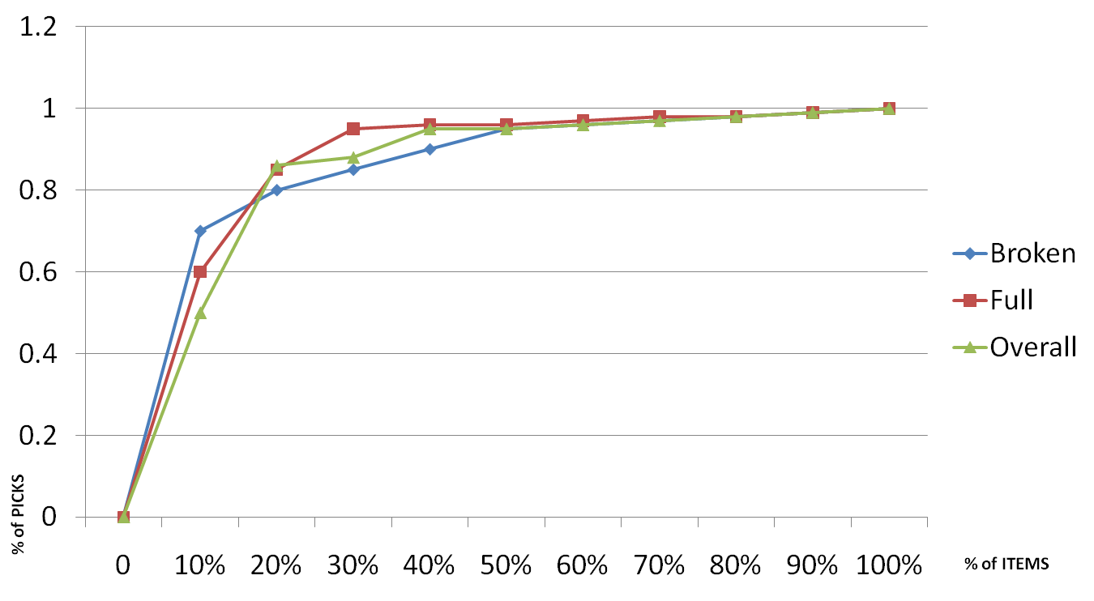
Popularity Distribution
Close to the door, close to the floor

Slide 22
Popularity Cube Movement
Cube Movement
Flow Rack
Bin Shelving
Carousels
Storage Drawers
Popularity

Slide 23
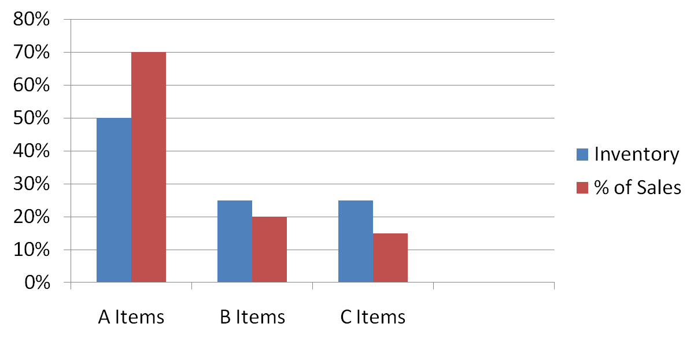
Item Family Inventory
Item-family inventory distribution
Handling unit inventory distribution

Slide 24
Inventory Profile
Item-family inventory distribution
Handling unit inventory distribution

Slide 25
Calendar – Clock Profile
Seasonality Distribution
Daily Activity Distribution

Slide 26
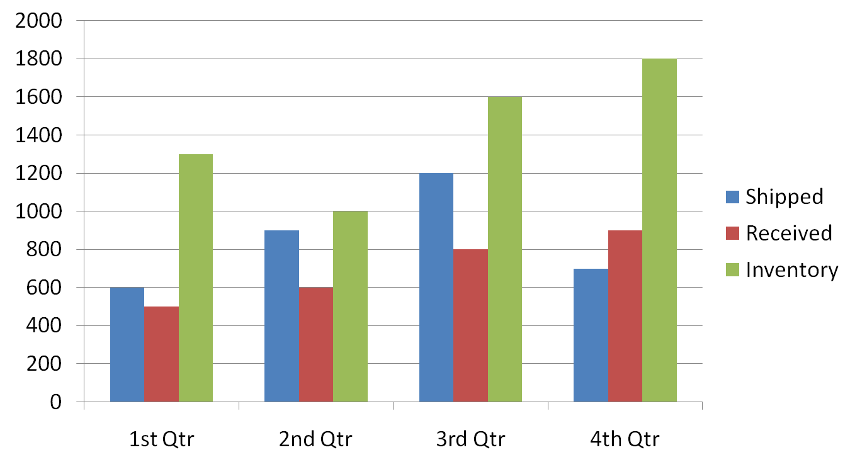
Seasonality Distribution
Seasonality Distribution
Daily Activity Distribution

Slide 27
Other Profiles
Activity relationship Profile
Investment Profile
Wage rate
Cost of space
Cost of capital
Required ROI
Work days per year
Planning horizon

Slide 28
Warehouse Design Issues and related Profiles
Planning & Design | Key Questions | Required Profile | Profile Components
Order picking and shipment process design | Order batch size Pick wave planning Picking tour construction Shipping mode disposition | Customer Order Profile | Order Mix Lines per order Lines and cube per order
Receiving & Putaway process design | Receiving mode disposition Putaway batch size Putaway tour construction | Purchase Order Profile | Order mix distributions Lines per receipt Lines and cube per receipt
Slotting | Zone definition Storage mode selection and sizing Pick face sizing Item location assignment | Item Activity Profile | Popularity Cube-movement/volume Popularity-volume Order completion Demand correlation Demand variable
Material Transport Systems Engineering | Material handling systems selection and sizing | Calendar-clock Profile | Seasonality profile Daily activity profile
Warehouse layout and material flow | Overall warehouse flow design: U, S, I, or L Relative functional locations Building configuration | Activity relationship Profile | Activity relationship distribution
Warehouse Sizing | Overall warehouse space requirements | Inventory Profile | Item family inventory distribution Handling unit inventory distribution
Level of automation and staffing | Staffing requirements Capital-labor substitution Level of mechanization

Slide 29
Preparing a Profile
Suggestions for getting started
Prepare the data: Organize it. Perform consistency checks. Identify missing or inconsistent data and develop a plan for handling them (Fix? Ignore?).
Profiling warehouse activity in the zones of interest to us: What are the most popular skus? What are the most popular vendors? How much space is devoted to each sku and to each vendor? What is the distribution of lines-per-order in Zones B and C? How many picks come from each zone? How many picks come from reserve locations and how many from active pick locations? Which sku's have reserve locations and in what zone?
Prepare a visualization of which aisles are most visited. For more detail, prepare a visualization of which sections of shelf are most visited. Here is version 0.1 of a tool to generate such a visualization. (Note: It would be helpful and not hard for you to adapt this tool, make it more general, and provide more adequate documentation. Making this tool more generally useful could be a significant contribution even though it does not directly address the client's issues.)
Has SPR chosen the correct skus to store in the fast-pick area and the correct amounts? Use a spreadsheet to check this via the fluid model.
If a fast-pick area seems a promising idea, use commercial software to slot it and the reserve area.
Finally, do not work only on slotting. This is a complicated issue at SPR. (It might be valid to conclude that a fast-pick area offers them too little benefit for the complexity of design and maintenance.) Do not lose sight of the big issue: How can pick-rates be increased?

