Slide 1
Order Picking Operations
Chapter 8 Warehouse management

Slide 2
Operating Cost Distribution

Slide 3
Order Picking Operations
63% of all operating costs
→ picking
Most labor intensive function
→ picking
Most material and handling equipment
→ picking
Most Decision Support & engineering project
→ picking
Most Warehouse Errors
→ picking

Slide 4
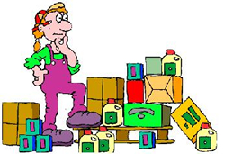
Picking Challenges
(JIT) Just in Time
Cycle Time Reduction
Quick Response
Micromarketing
Megabrand Strategies
More frequent smaller orders
More SKU’s

Slide 5
Picking Strategies
Issue pack optimization
Pick-from-storage
Pick task simplification
Order batching
Slotting optimization
Pick sequencing

Slide 6
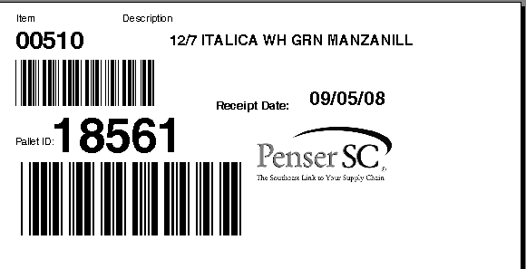
Bar Code License Plates

Slide 7
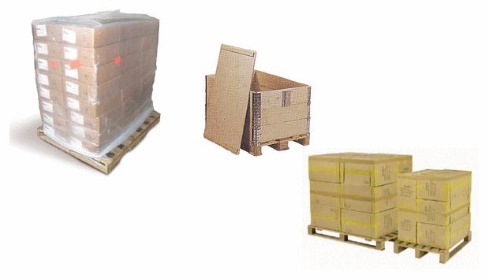
I. Issue Pack Optimization
Match the storage unit to the shipping unit

Slide 8
II. Pick from Storage
Replenishment
Reserve Storage & Pallet Picking
Case Picking
Broken Case Picking
Customization
Picking
Direct Put away
Direct Put away
RECEIVING
Crossdock
SHIPPING

Slide 9
III. Pick Task Simplification
Eliminate and combine order picking tasks when possible
Traveling | Extracting | Reaching & Bending
Documenting | Sorting | Picking
Searching

Slide 10
Distribution of Order Pickers Time

Slide 11
Picking Work Elements
Work Element | Method Elimination | Technology/Function
Traveling | Bring pick loc to picker | Stock to picker system; ASRS/ Carousel
Documenting | Auto info flow | Computer aided picking/ light aided pick/RF Terminals/Headsets
Reaching | Present items at waist level | Carousel/ASRS
Searching | Illuminate pick locs, bring pick loc to picker | Stock to picker systems/Pick to light/ASRS
Extracting | Automated dispensing | Auto item pickers/robotics
Counting | Weigh counting/prepackage | Scales on pick vehicles
Restocking | Auto look-ahead | Min-max triggers
Excessive Socializing | Assign operators to dedicated zones
Idling/waiting for work | Dynamic zone sizing/perpetual to-do lists

Slide 12
IV. Order Batching
Increasing the number of orders picked by an order picker during a pick tour.

Slide 13
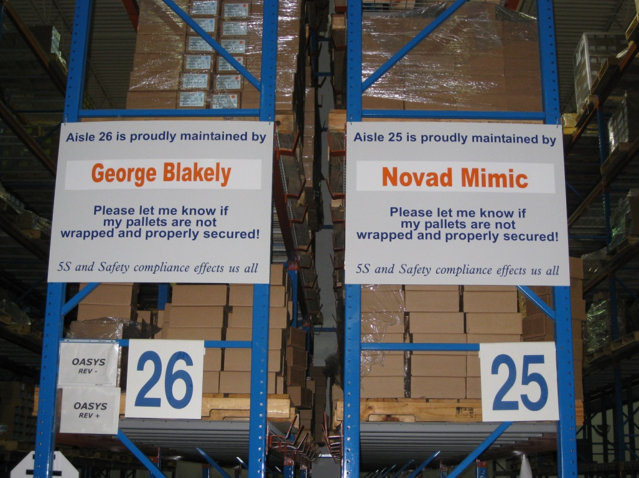
Zone Picking
Pro’s
Travel time is reduced
Operators familiarity with material
Congestion is minimized
Zone accountability
Minimizes socializing

Slide 14
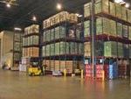
V. Slotting Optimization
For each Item Determine:
Appropriate storage mode
Appropriate allocation of space
Appropriate storage location
Slotting impacts all of the KPI’s: productivity, shipping accuracy, inventory accuracy, dock-to-stock time, warehouse order cycle time, and storage density,

Slide 15
Slotting Methodology
Conduct a warehouse operations audit
Populate the slotting database
Compute slotting statistics
Construct the warehouse profile
Assign items to item families
Assign item activity families to storage mode families
Map the warehouse locations within each storage mode
Based on pick density, assign items to mode activity zones
Specify reslotting rules

Slide 16
VI. Pick Sequencing
Start

