Slide 1
LEAN Principles & Tools
Warehouse management

Slide 2
“In times of change learners inherit the earth; while the learned find themselves beautifully equipped to deal with a world

Slide 3
Lean Tools & Techniques
5S
Level Scheduling
Kaizen
Poke-Yoke
FMEA

Slide 4
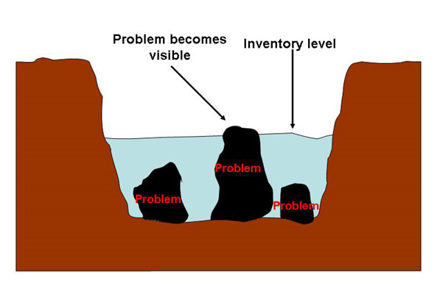
Definition of Lean
A methodical approach to shortening the time between the customer’s order and the delivery of the product by eliminating waste and maximizing flow

Slide 5
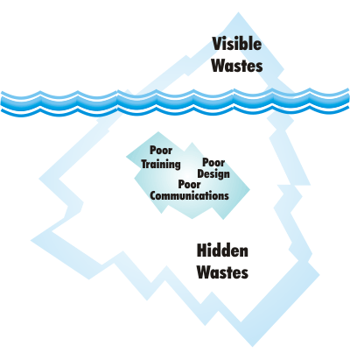

Slide 6
8 Wastes (MUDA)
Defects
Order Entry, Design, Layout, rework--redo
Waiting
System downtime, response time, approvals, unbalanced workload, unreliable equipment
Overproduction
Printing paperwork, unnecessary copies, phone calls
Transportation
Multiple sites, travel to tools, long lead times
Inventory
Office supplies, sales literature, reports, obsolete documents
Complexity
Re-entry of data, extra copies, excessive reporting
Underutilization of resources
Limited tools or authority
Motion
Searching for documents, excessive keystrokes, walking to printers/fax/copiers

Slide 7
What is Lean?
LEAN =
Shortened Lead Times
Reduced Costs
Improved Quality
Flexible Processes
Culture of Continuous Improvement
Philosophy: Produce only what is needed when it is needed with the least amount of resources
Methodology: Identify the value stream and then identify and eliminate waste
Set of Tools: Used throughout the entire business enterprise

Slide 8
Lean Principles
Specify VALUE of service
Identify the VALUE STREAM for each service
Allow the Customer to PULL value from the stream
Continuously Improve …Pursue PERFECTION

Slide 9
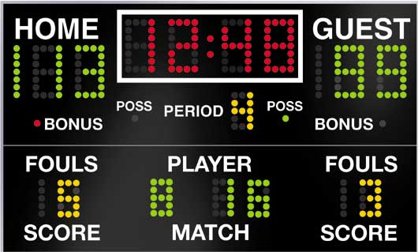
Visual Management
A visual workplace is a work environment that is self-explaining, self-regulating, and self-improving, where what is supposed to happened does happen, on time, every time.

Slide 10
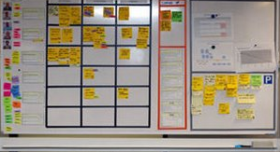
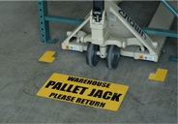
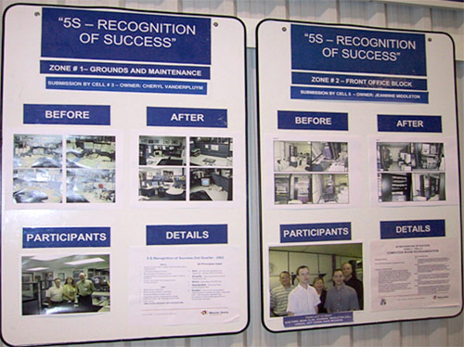
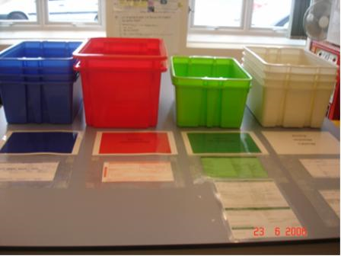

Slide 11
Visual Management Guidelines
Easy to see from a distance
Put the displays on the things they are for
Easy: anyone can tell what is right and what is wrong
Anybody can follow them
Makes the workplace bright and more orderly

Slide 12
Lean 5S

Slide 13
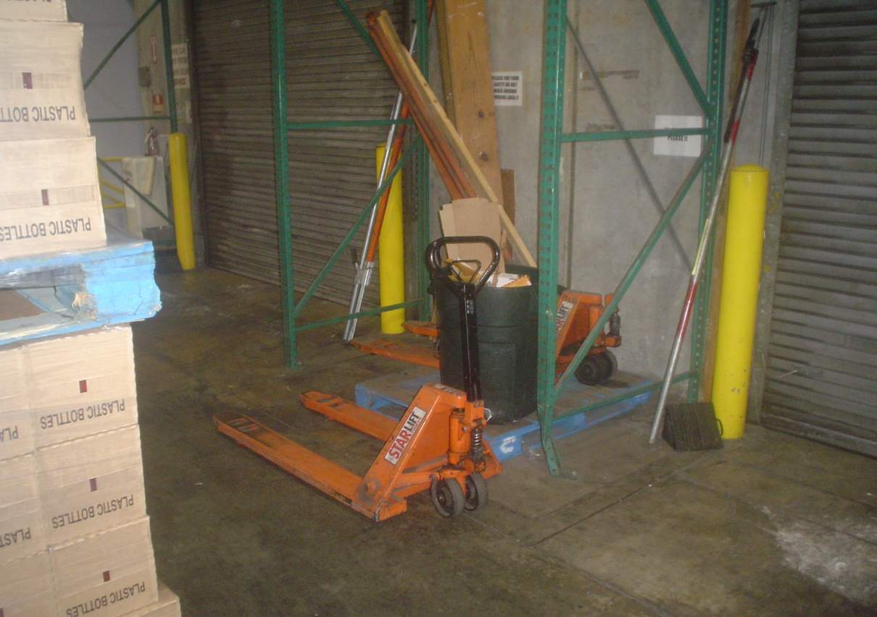
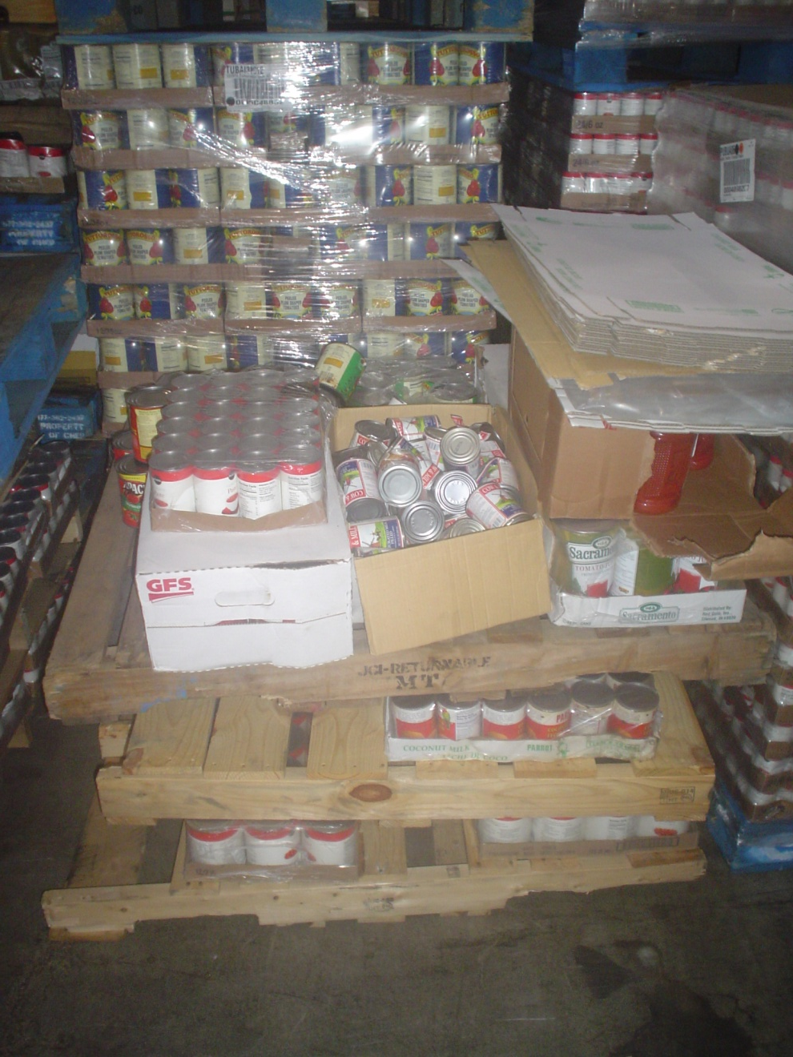
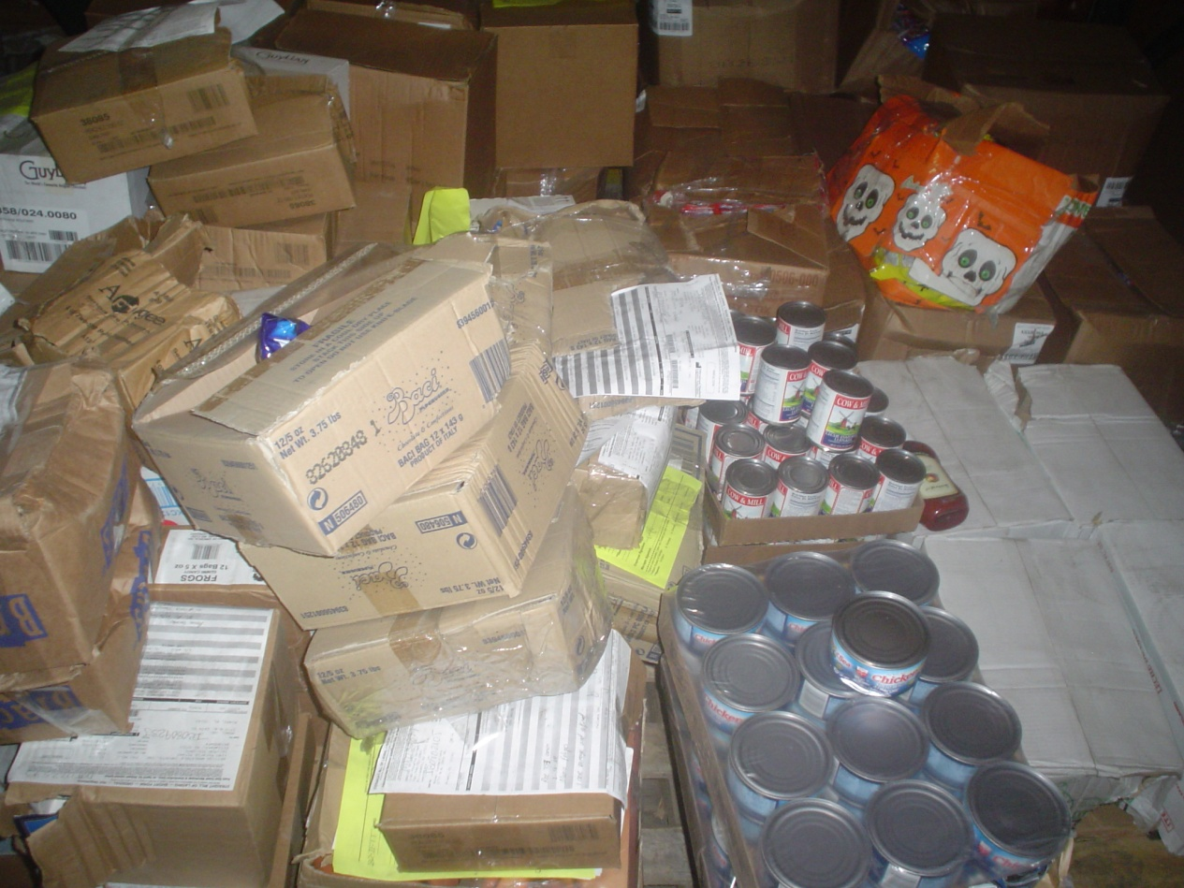

Slide 14
Why 5S
Foundation of Lean Operations.
5S and Visual Controls ensure that there is a place for everything and that everything is in its place—clean and ready to use.

Slide 15
Benefits of 5S
Improve safety
Decrease down time
Raise employee morale
Identify problems more quickly
Develop control through visibility
Establish convenient work practices
Increase product and process quality
Strengthen employee pride in their work
Create more space for production

Slide 16
The 5 S’s
Sort
Clearly distinguish needed items from un-needed items and eliminate the clutter
Set in Order
Keep needed items in the correct place to allow for easy and immediate retrieval
Shine
Cleanliness
Standardize
This is the condition we support when we maintain the first three pillars
Sustain

Slide 17
SORT
Stage 1:
Organize the work area, leaving only the tools and materials necessary to perform daily activities.
When “sorting” is well implemented, communication between workers is improved and product quality and productivity are increased.

Slide 18
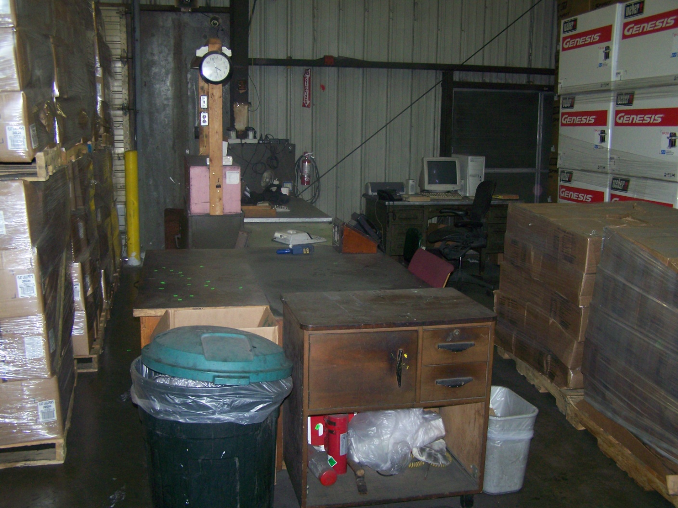
SORT
Organize work area for max possible efficiency

Slide 19
SORT → How?
An effective visual method is red tagging.
A red tag is placed on all items not required to complete your job.
These items are then moved to a central holding area.
Used items are moved to a more organized storage location outside of the work area while unneeded items are discarded.
Sorting is an excellent way to free up valuable floor space and eliminate such things as broken tools, obsolete jigs and fixtures, scrap and excess raw material.

Slide 20
SET IN ORDER
Stage 2:
The orderly arrangement of needed items so they are easy to use and accessible for “anyone” to find. Orderliness eliminates waste in production and clerical activities.

Slide 21
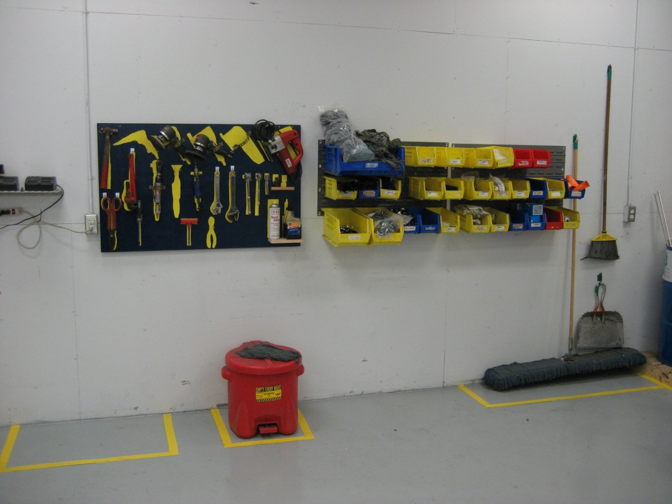
Set in Order
distinguishes needed items from unneeded items

Slide 22
Set in Order → How?
Ask these questions:
What do I need to do my job?
Where should I locate this item?
How many of this item do I need?
Strategies for effective Set In Order are painting floors, outlining work areas and locations, shadow boards, and modular shelving and cabinets for needed items such as trash cans, brooms, mop and buckets. Imagine how much time is wasted every day looking for a broom? The broom should have a specific location where all employees can find it.
"A place for everything and everything in its place."

Slide 23
SHINE
Stage 3:
Keep everything clean and swept.
maintain a safe work area.
An important part of “shining” is “Mess Prevention.”
Don’t allow litter, scrap, shavings, cuttings, etc., to land on the floor in the first place.

Slide 24
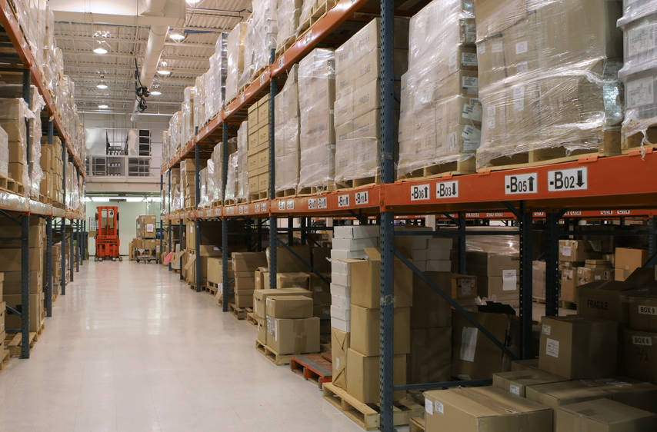
SHINE
thoroughly clean everything in the work area

Slide 25
SHINE → How?
Five-step process including:
cleanliness targets, assignments, methods, tools, and follow-up inspections.
The goal is threefold:
1) to turn the workplace into a clean, bright place where people enjoy working,
2) review the first two Ss,
3) find the source of dirt or litter and eliminate it.
Cleanliness = "keeping everything swept and clean." "Shine" should become so deeply ingrained as a daily work habit.

Slide 26
STANDARIZE
Stage 4:
Create a consistent approach for carrying out tasks and procedures. Orderliness is the core of “standardization” and is maintained by Visual Controls.
Signboard strategy
Signboard uses
Painting strategy
Color-coding strategy
Shadow boarding
Standardize “Best Methods” across the organization

Slide 27
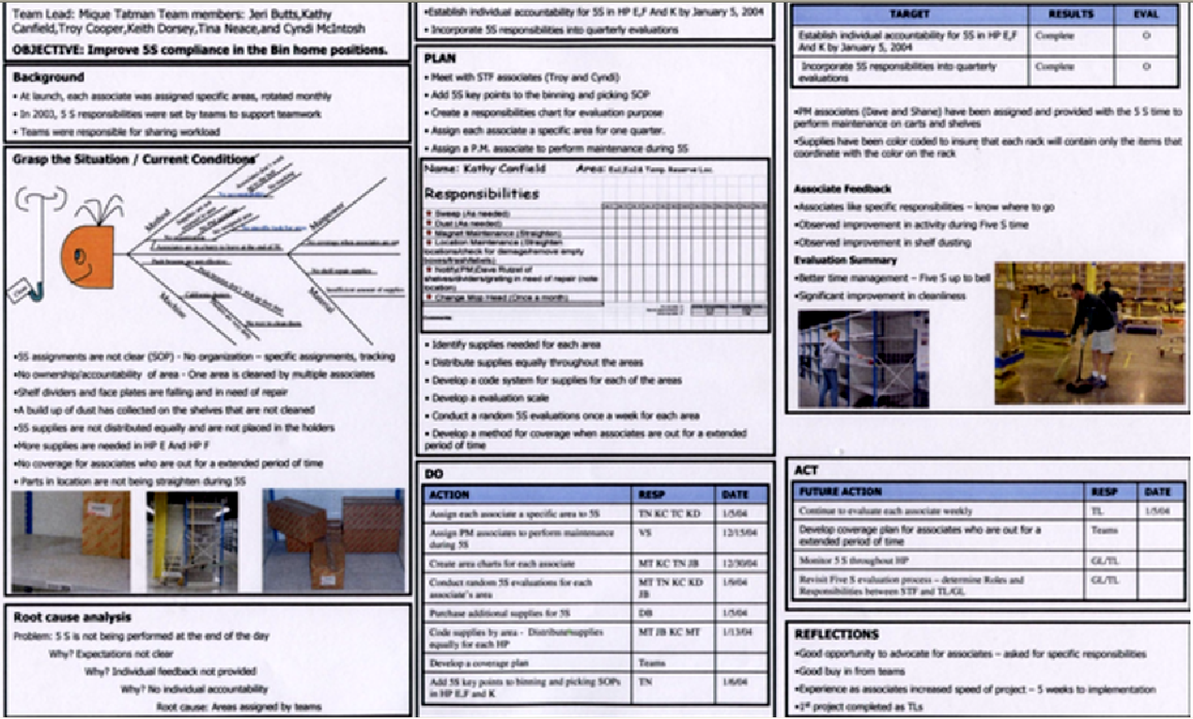
STANDARDIZE
“Standardize" details a plan to maintain the continual improvement activities

Slide 28
SUSTAIN
Stage 5:
Discipline and commitment of all other stages.
Without “sustaining”, your workplace can easily revert back to being dirty and chaotic. That is why it is so crucial for our team to be empowered to improve and maintain their workplace. When employees take pride in their work and workplace it can lead to greater job satisfaction and higher productivity.

Slide 29
SUSTAIN
This is by far the most difficult S to implement and achieve. Human nature is to resist change and more than a few organizations have found themselves with a dirty cluttered shop a few months following their attempt to implement 5S.
Fully implemented, the 5S process increases moral, creates positive impressions on customers, and increase efficiency and organization.

Slide 30
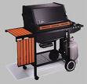
VIRTUAL TOUR
From our customer’s eyes

Slide 31
BEFORE

Slide 32
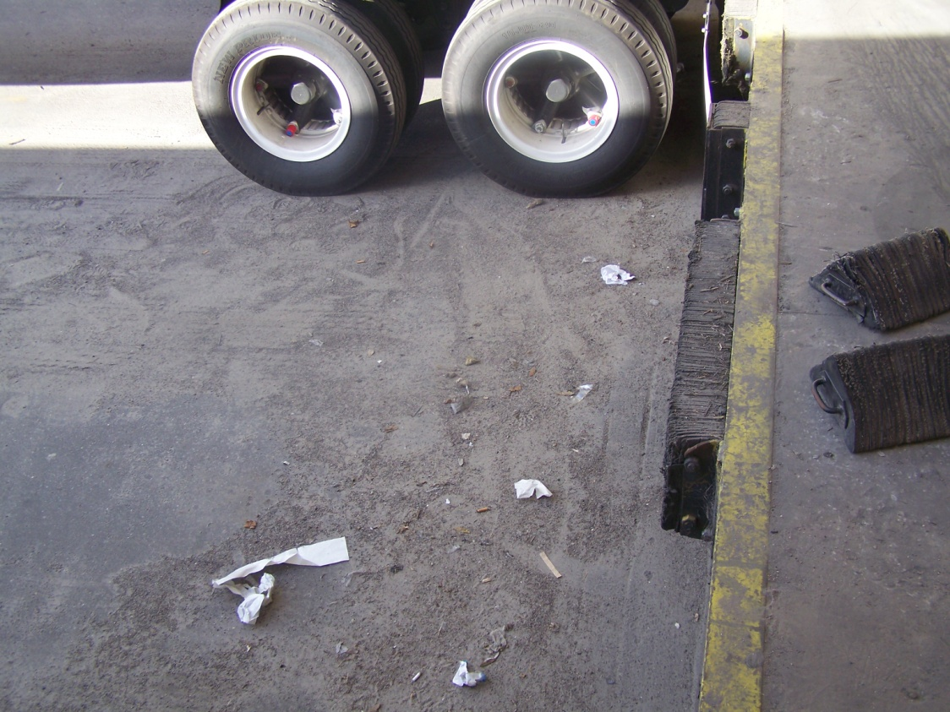
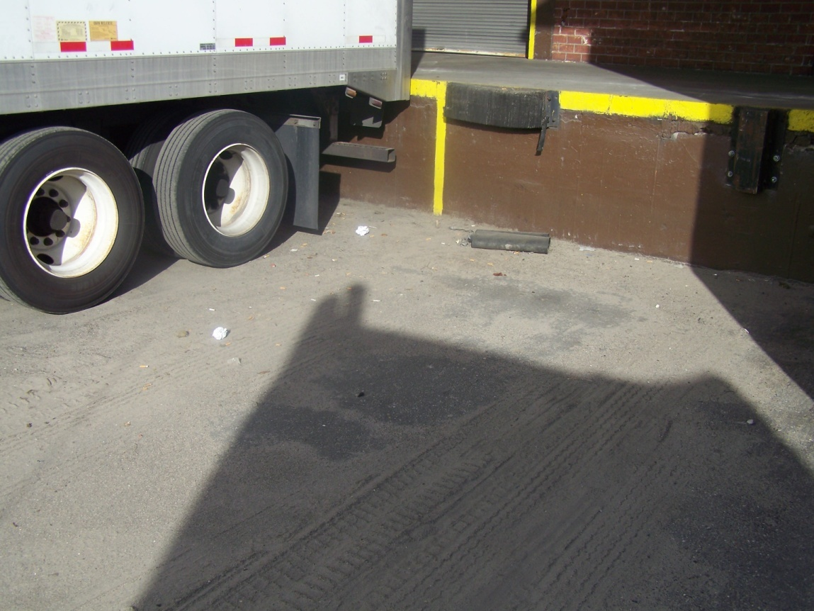
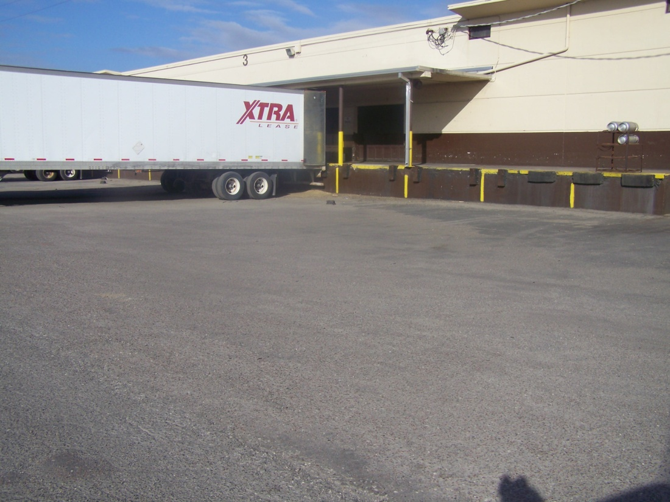

Slide 33
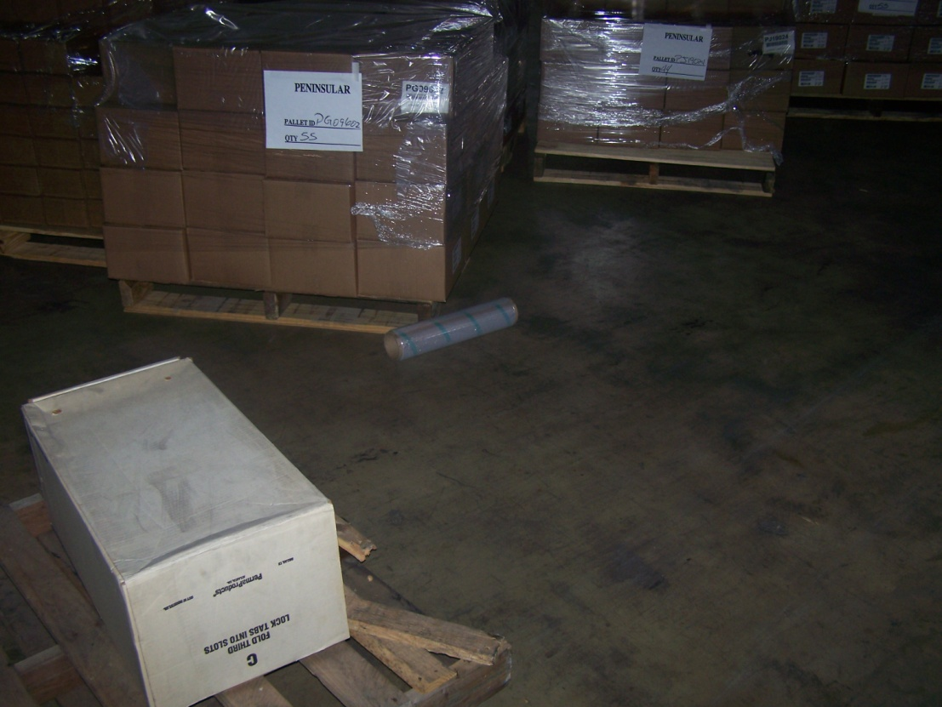
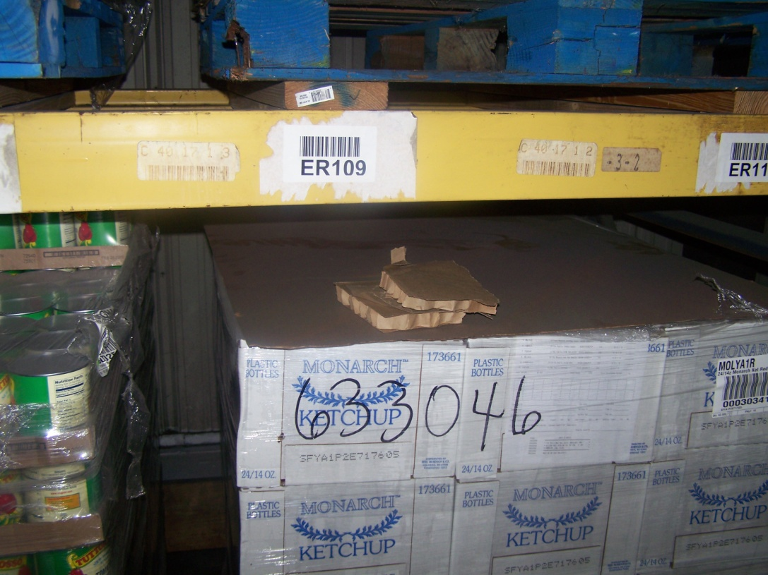
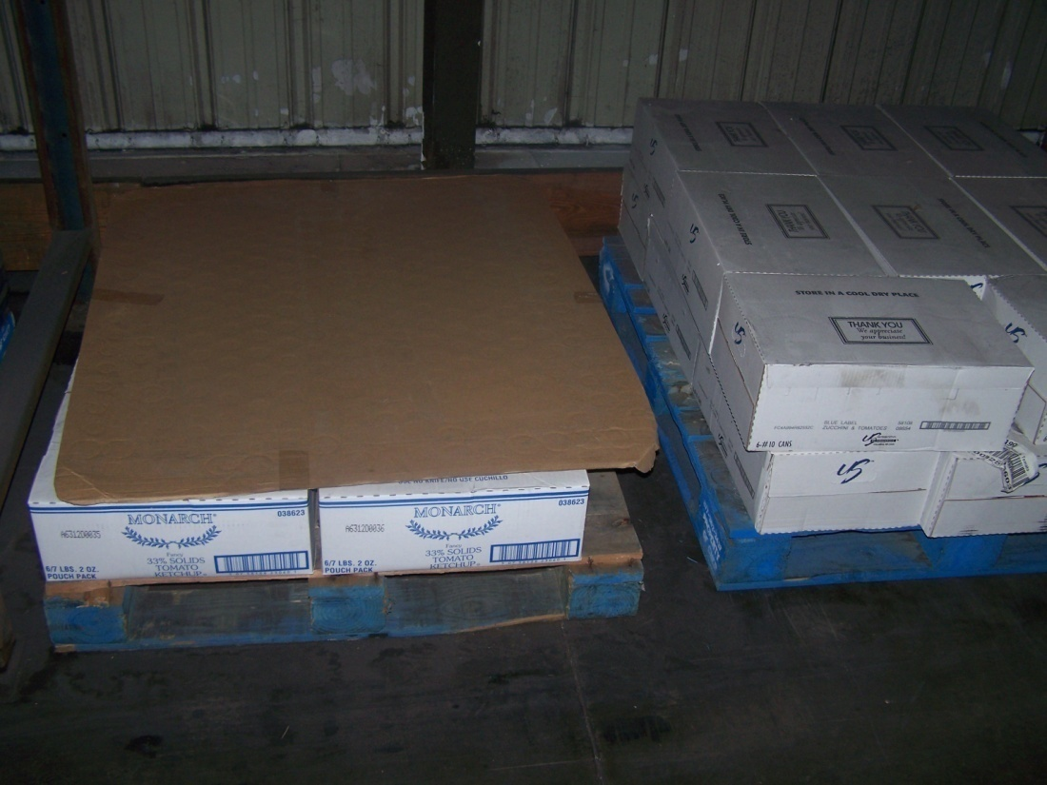
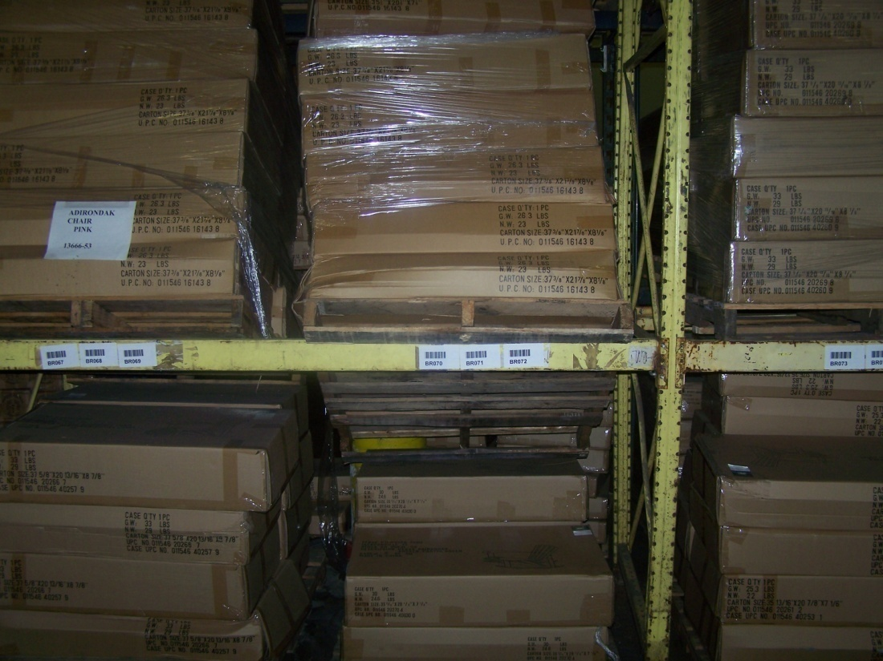

Slide 34
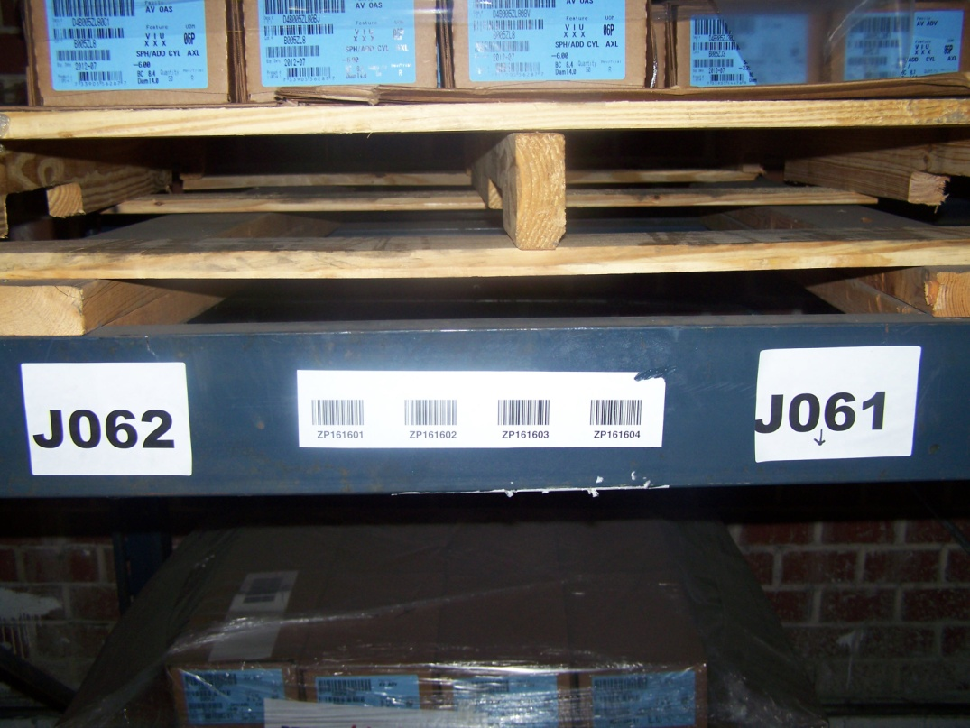
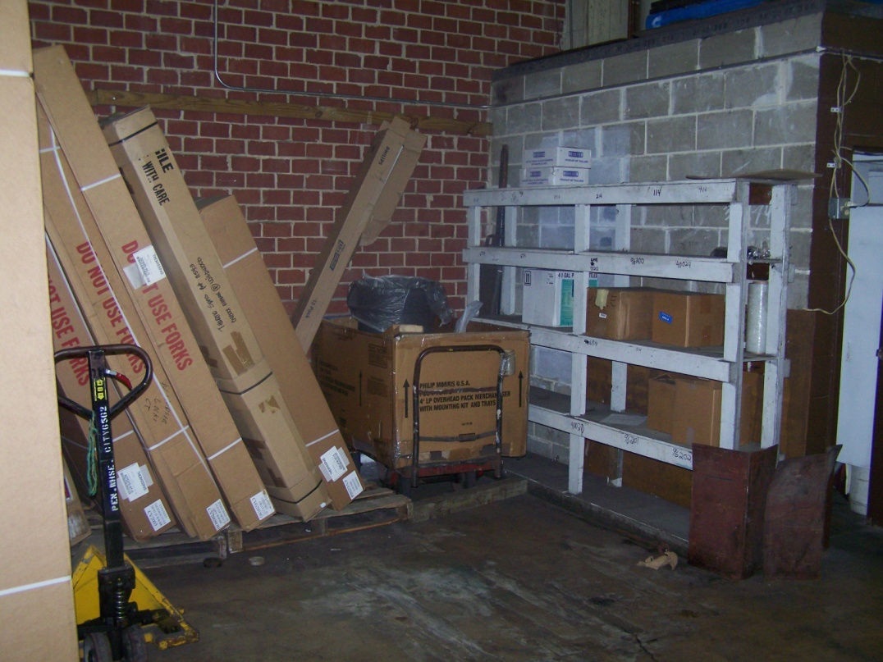
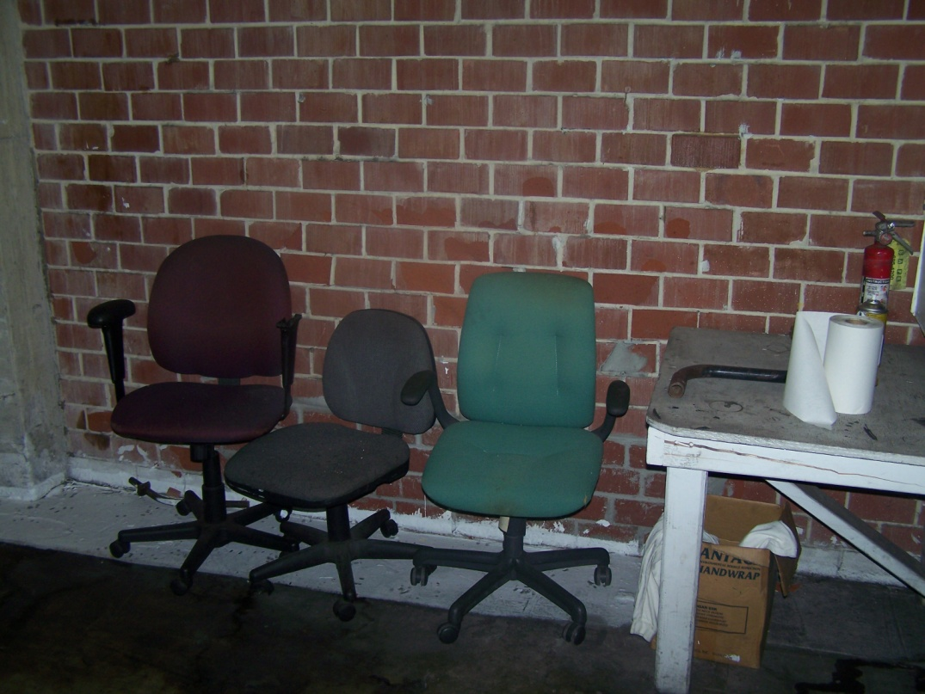
Building 2

Slide 35
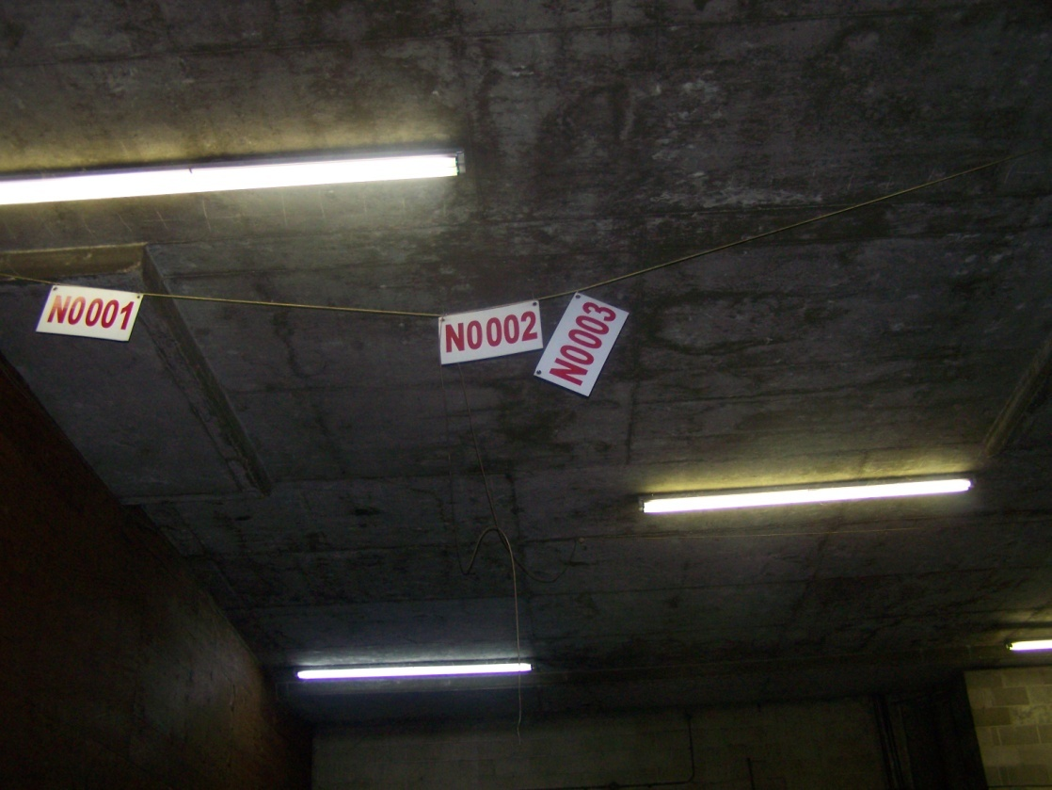
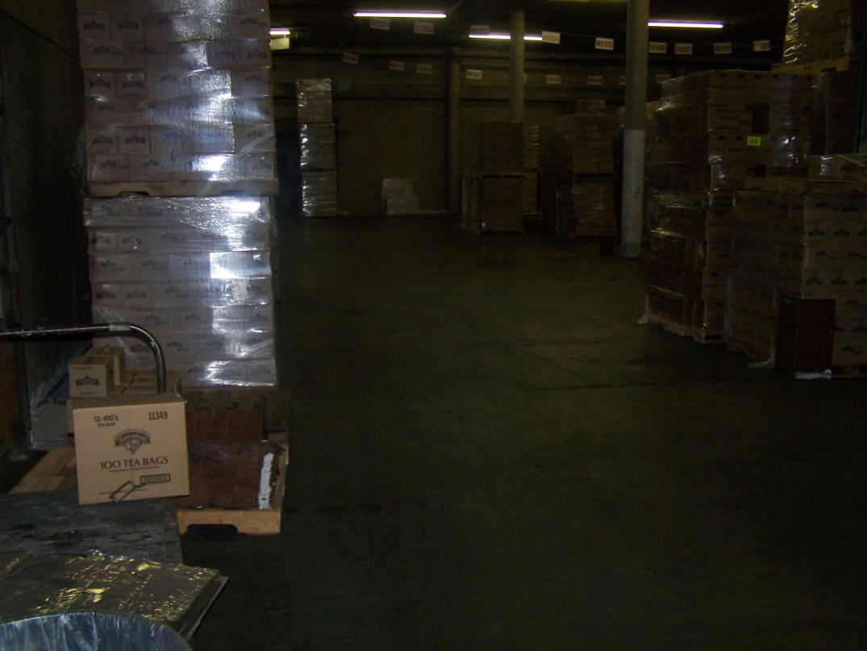
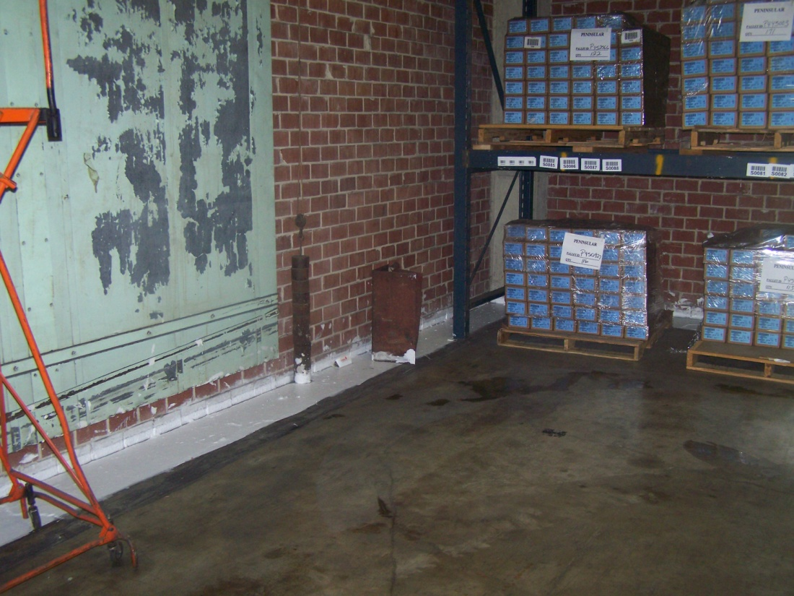

Slide 36
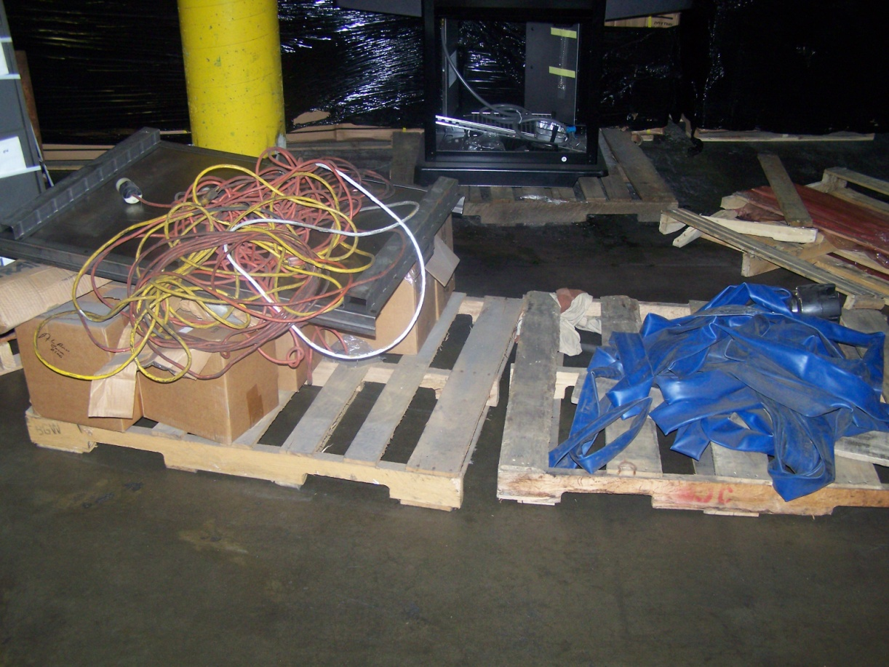
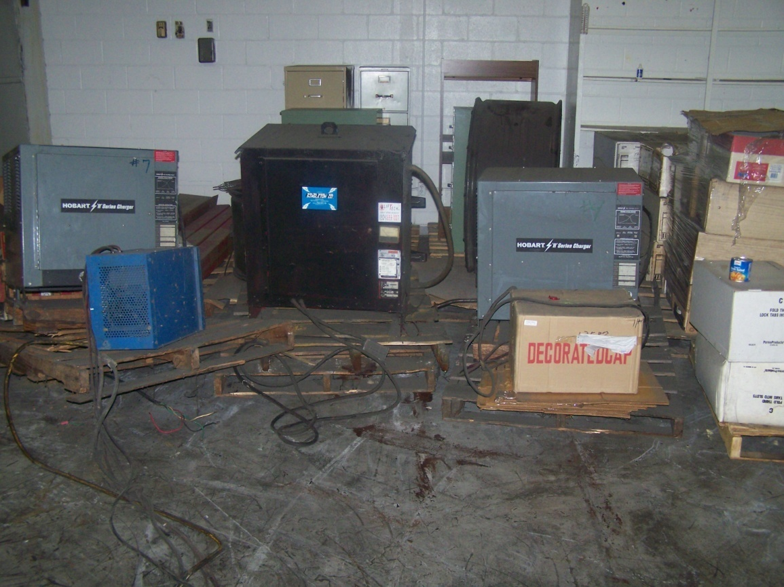
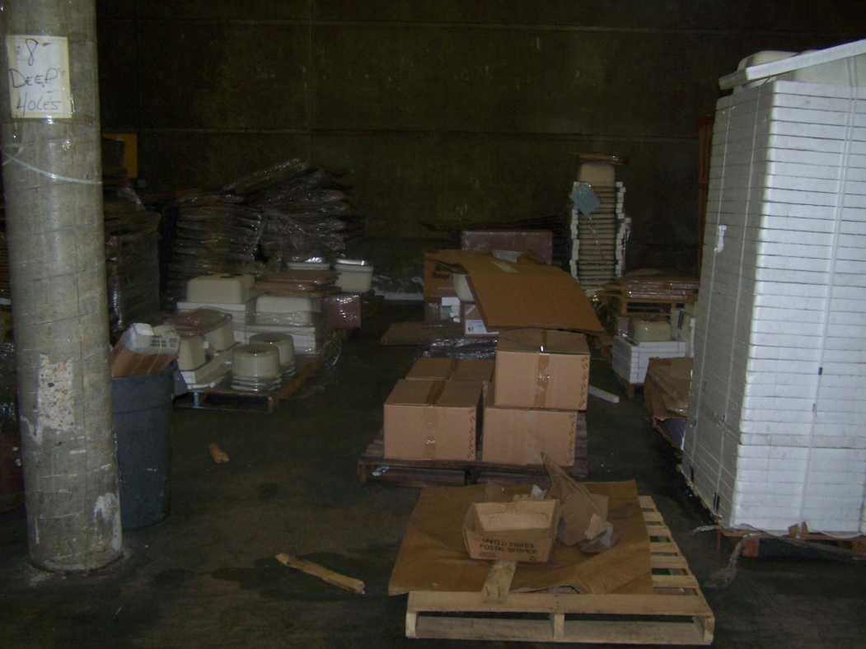

Slide 37
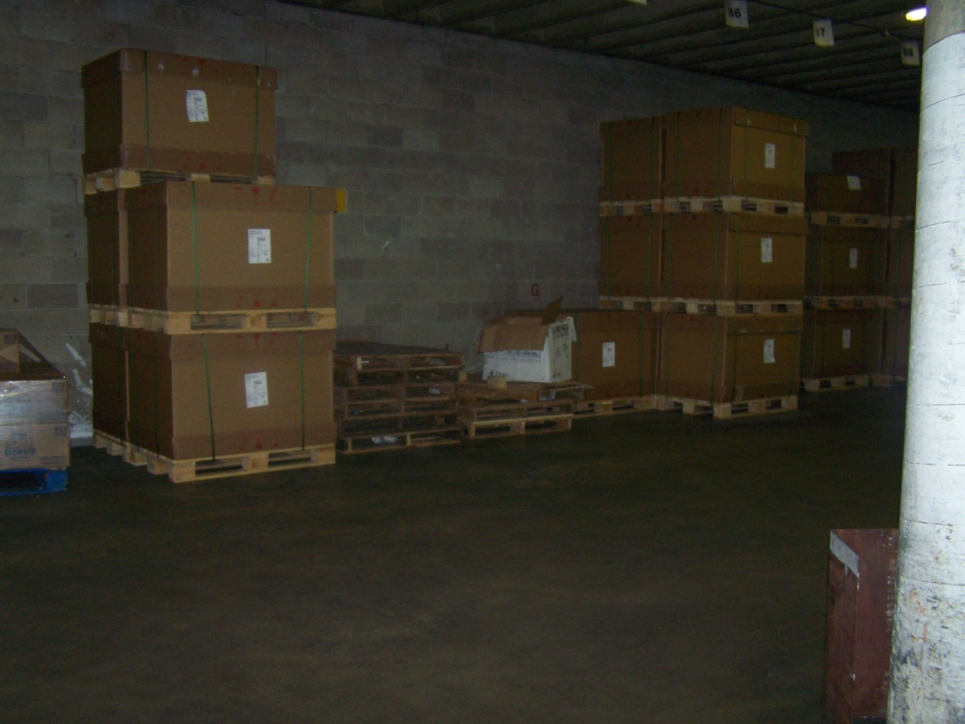
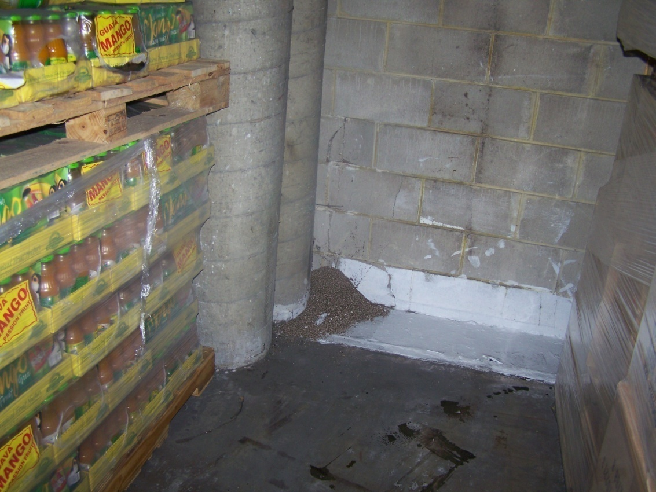
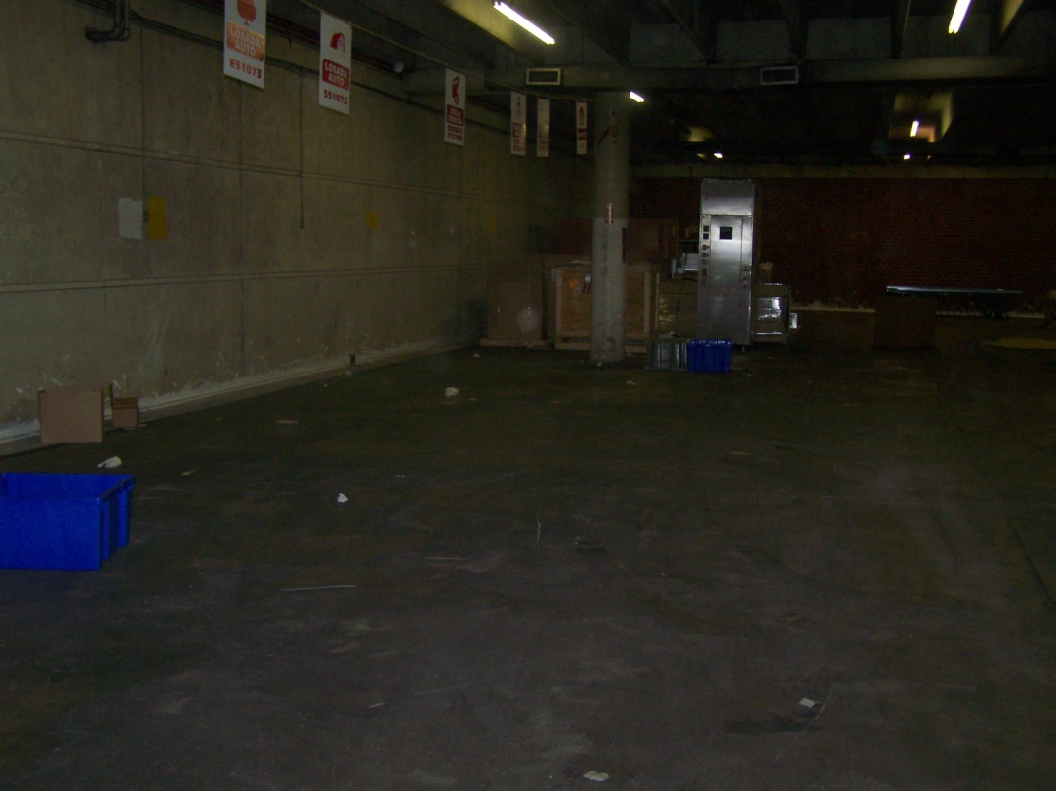

Slide 38
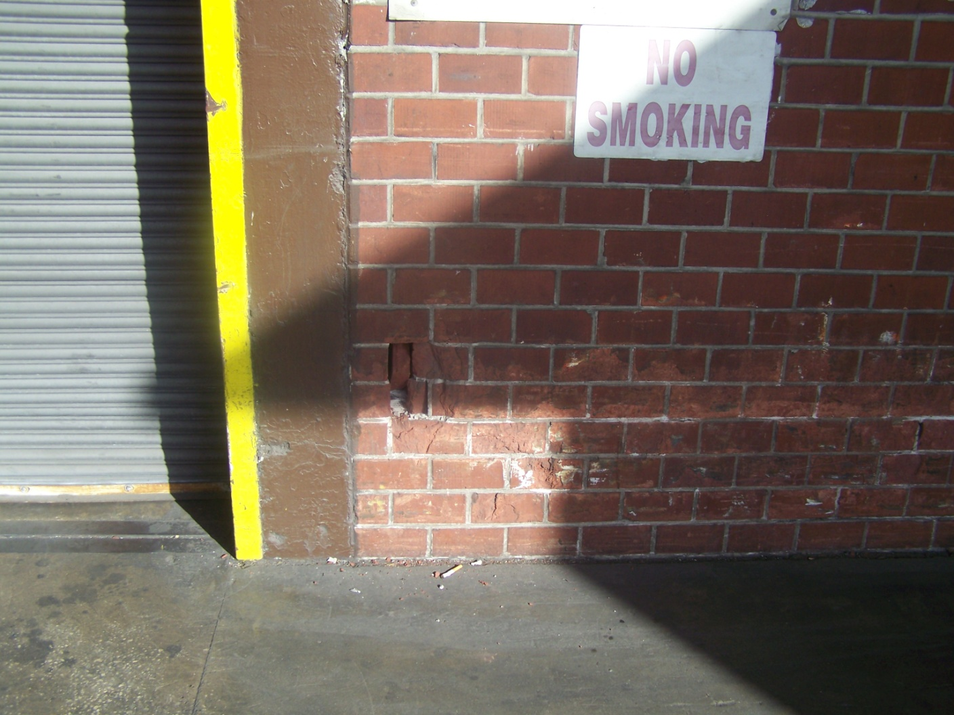
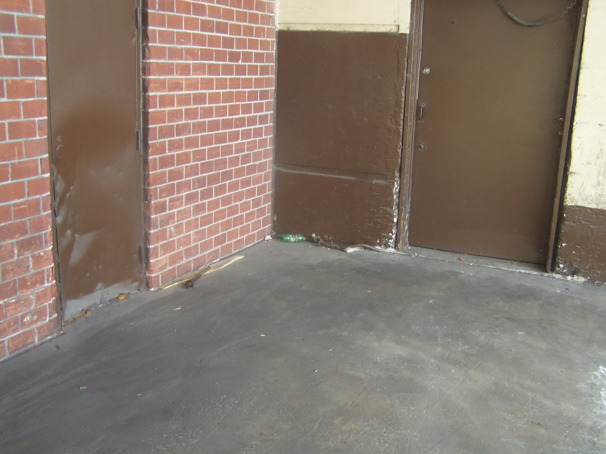
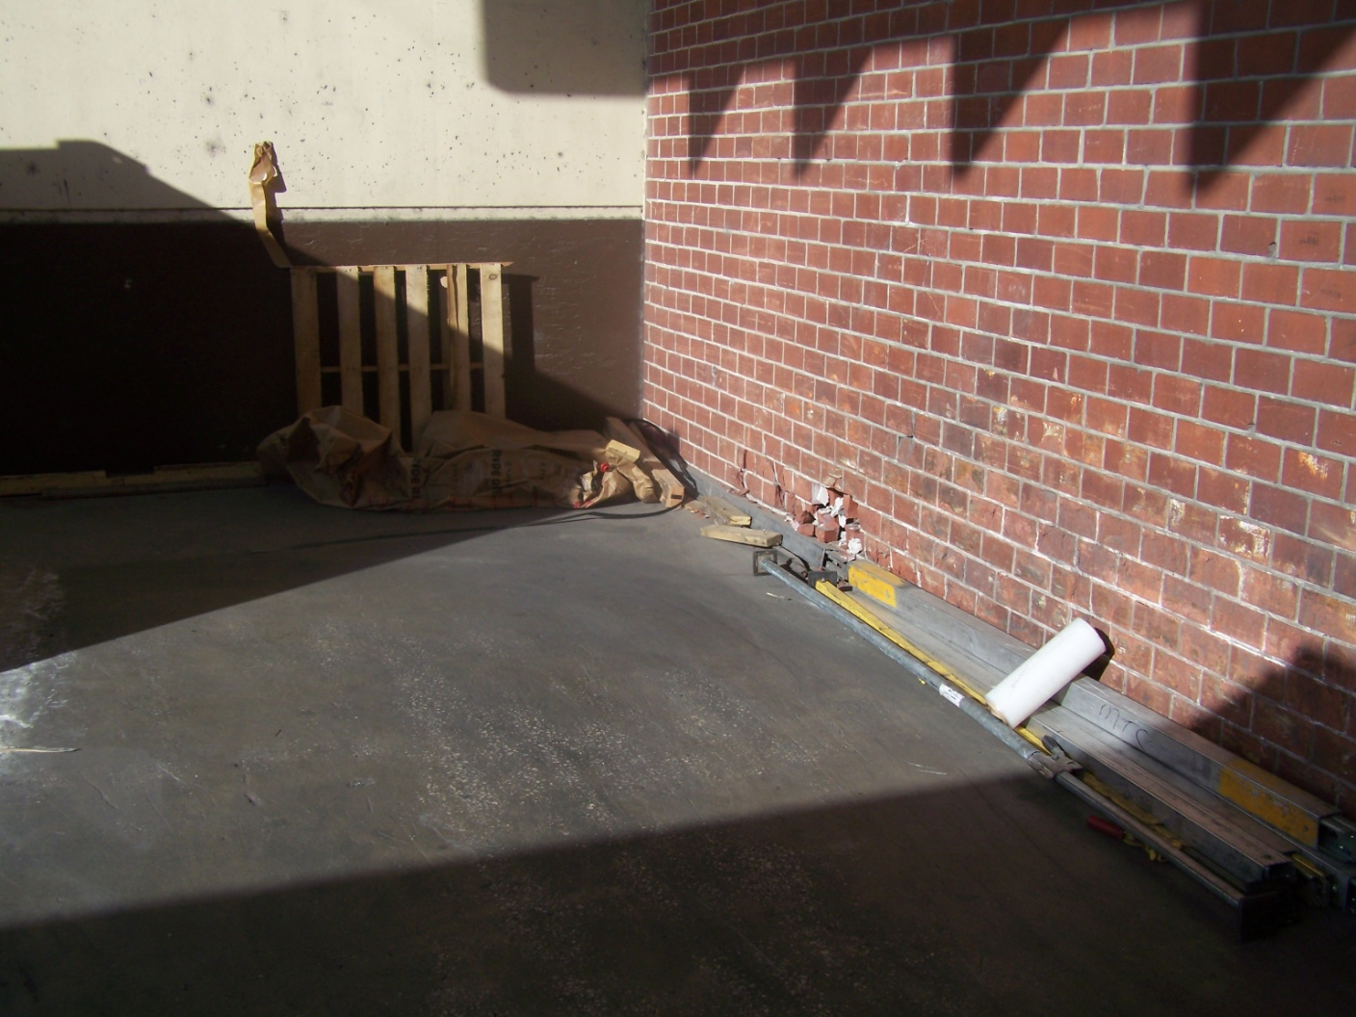

Slide 39
AFTER

Slide 40
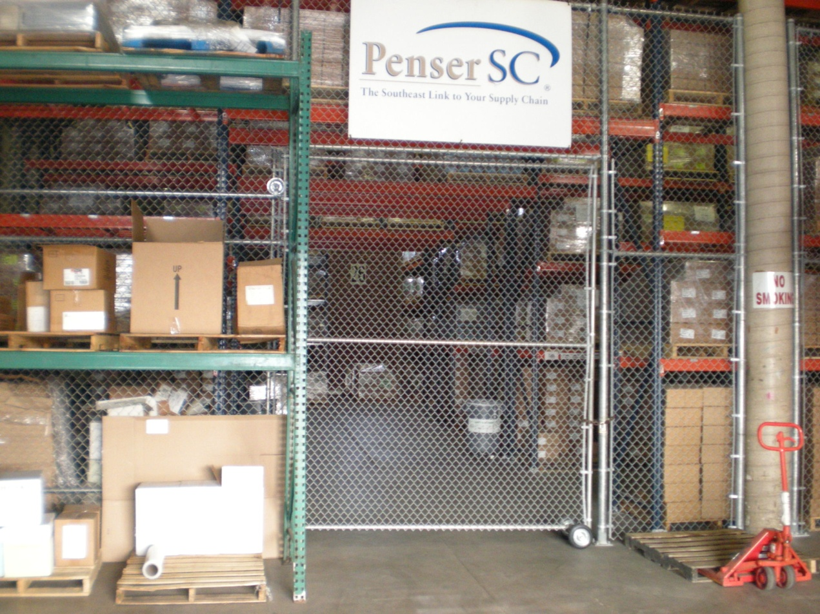
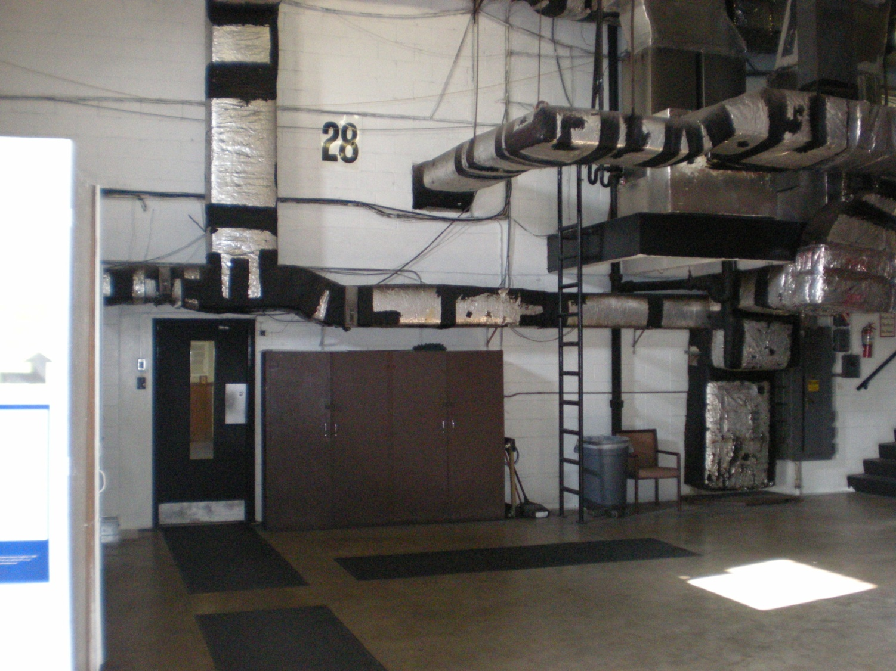

Slide 41
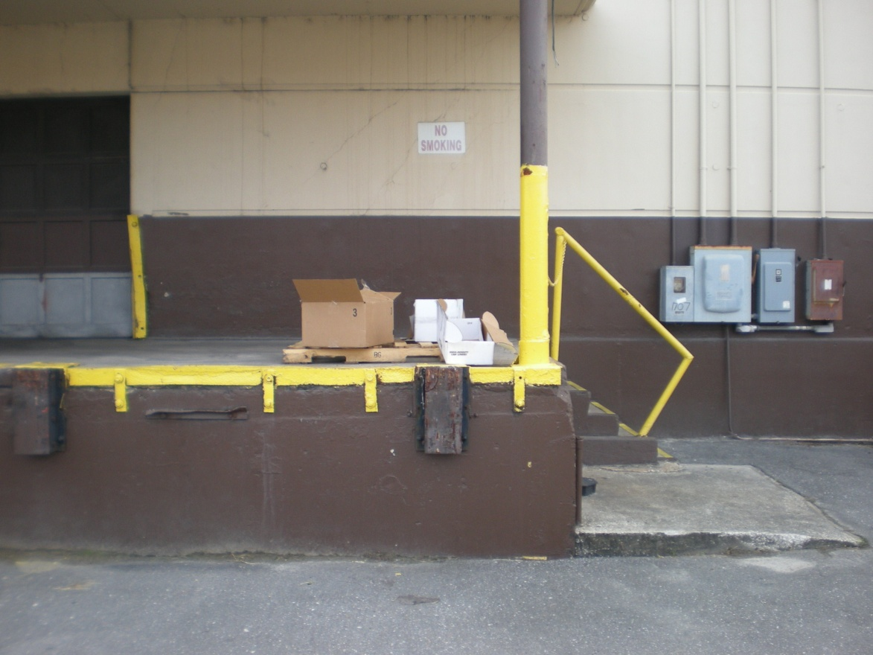
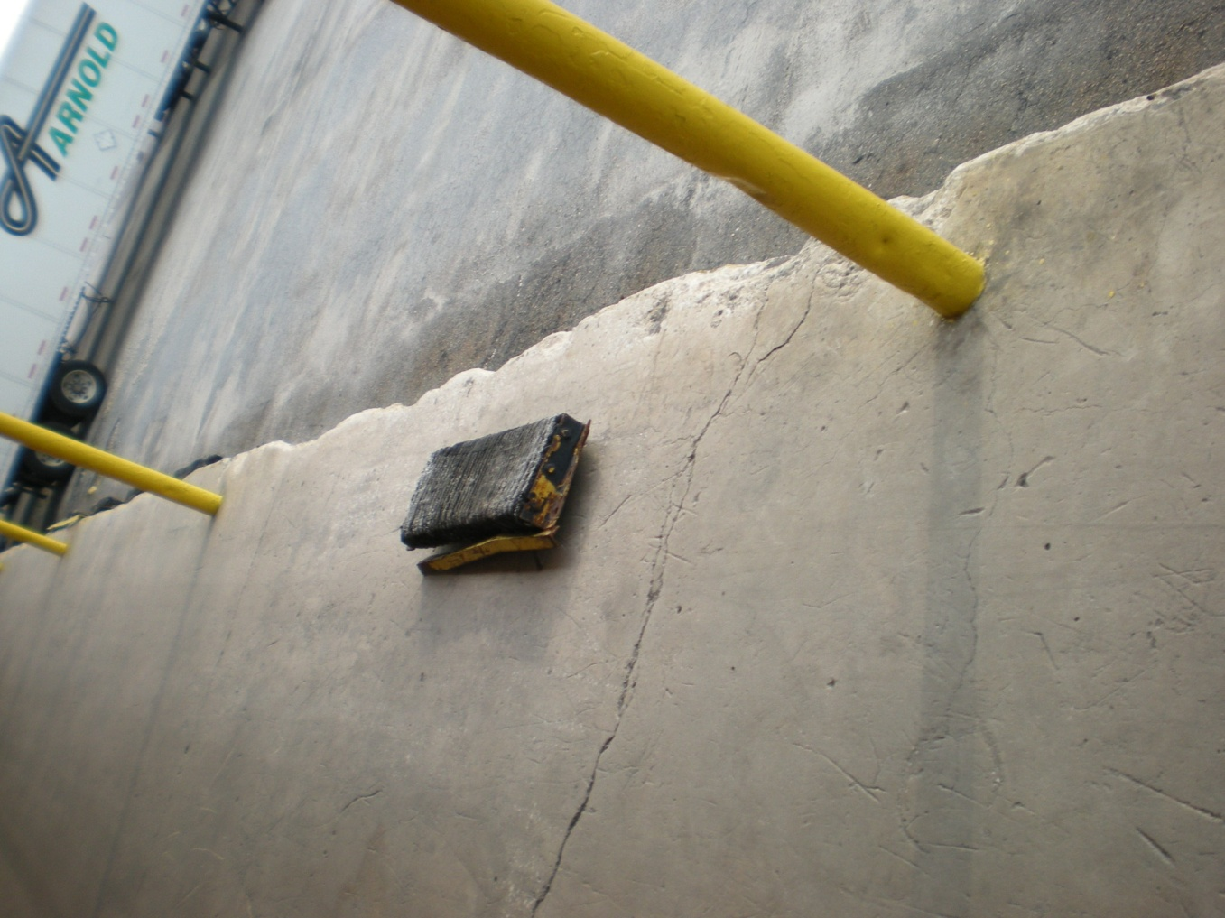

Slide 42
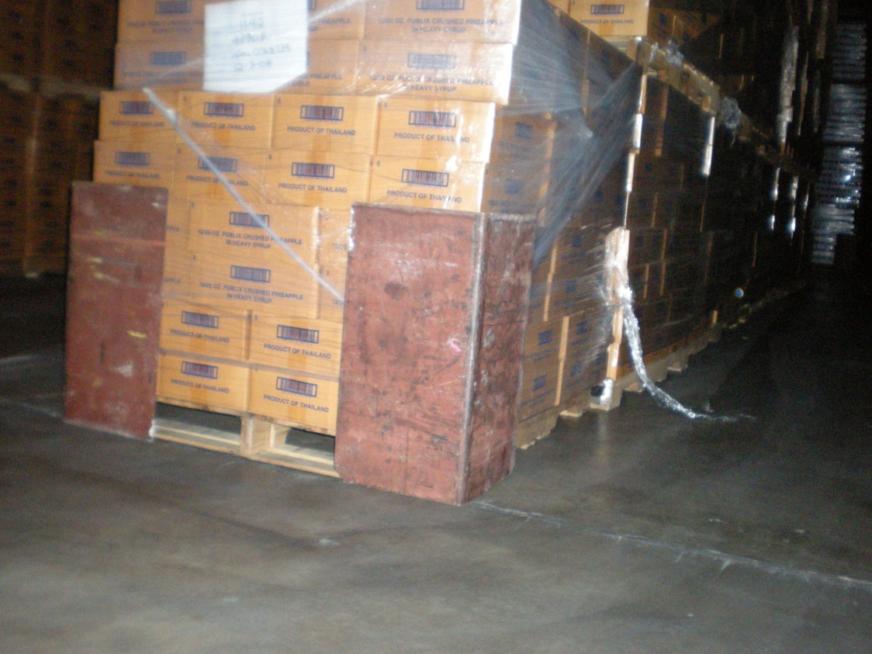
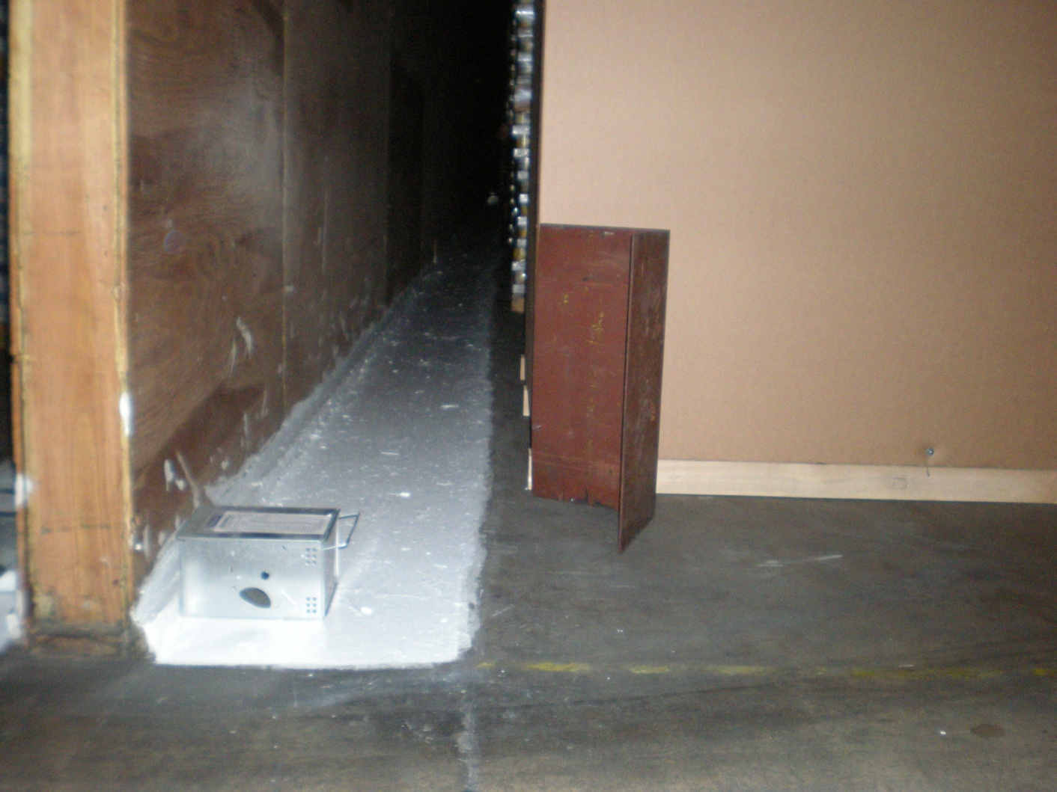

Slide 43
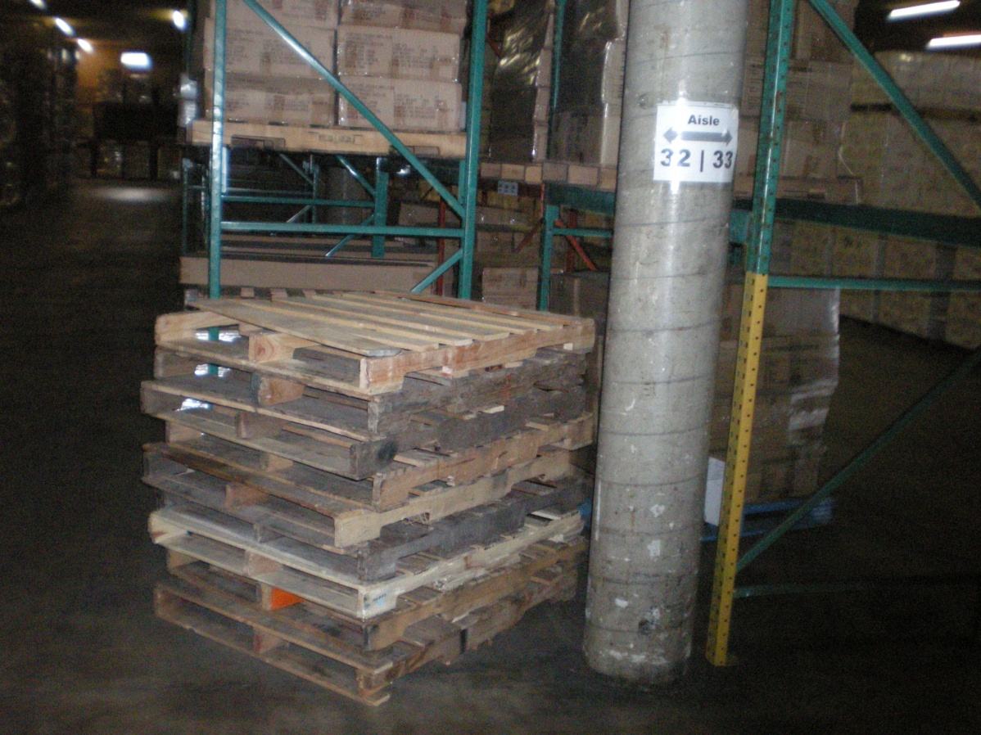
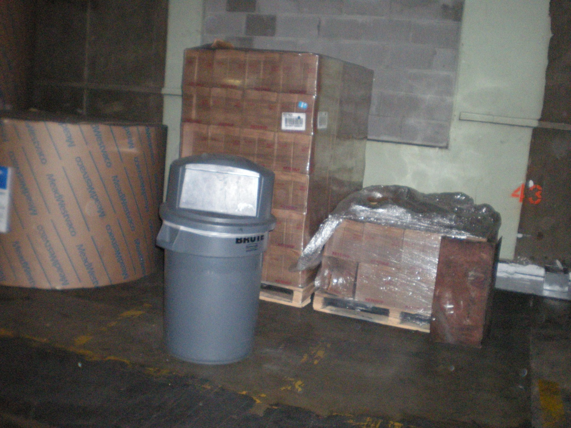

Slide 44
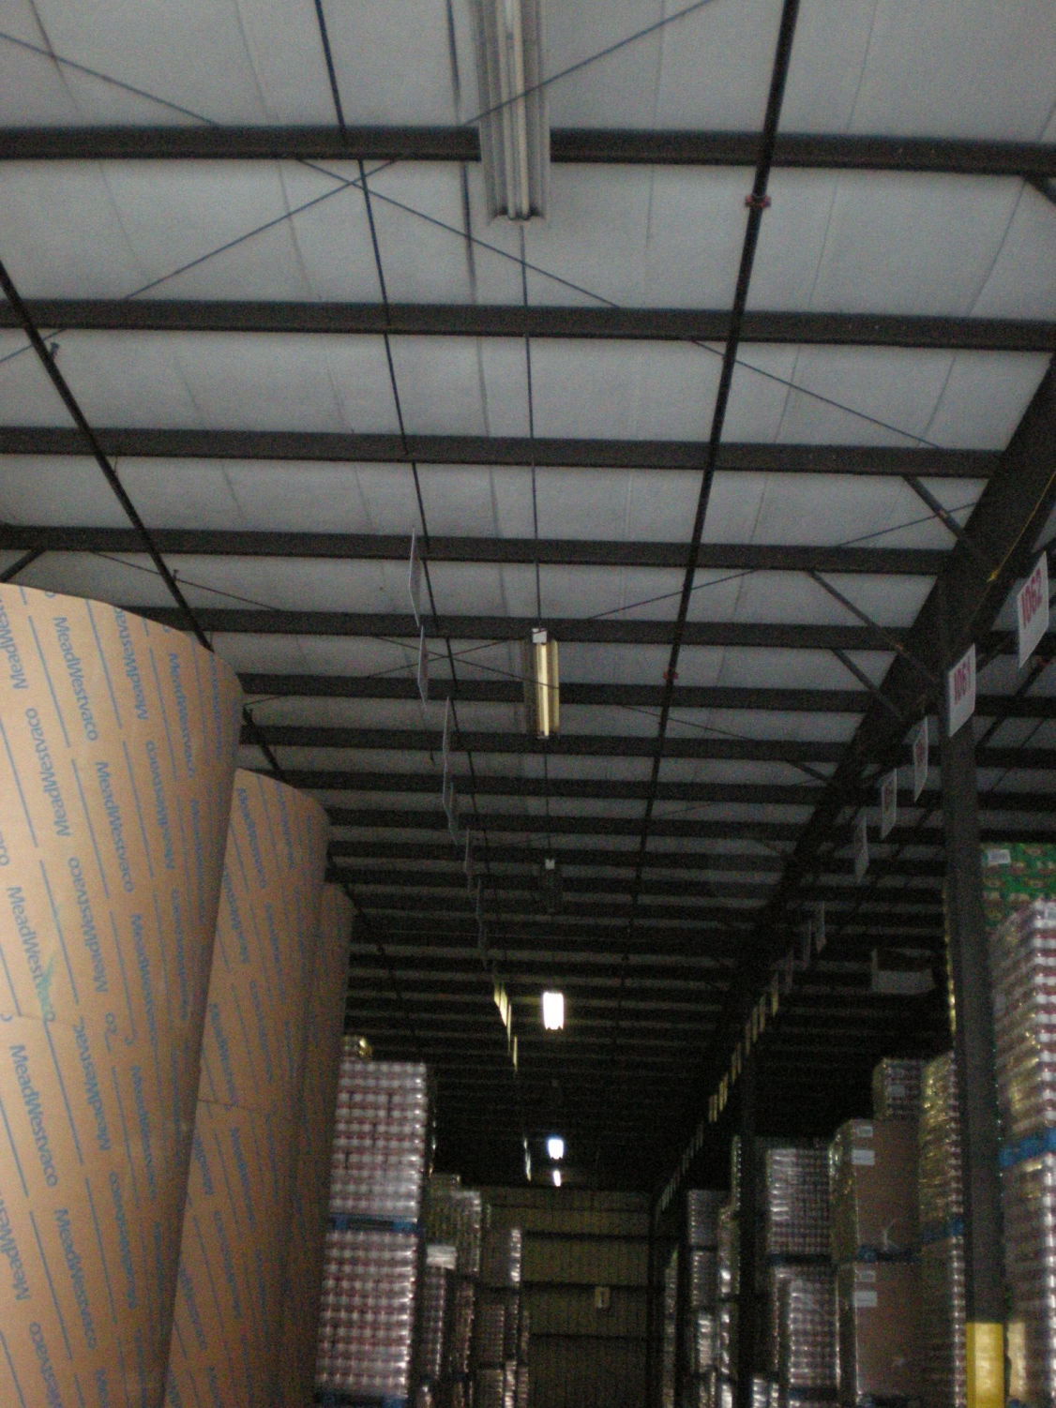
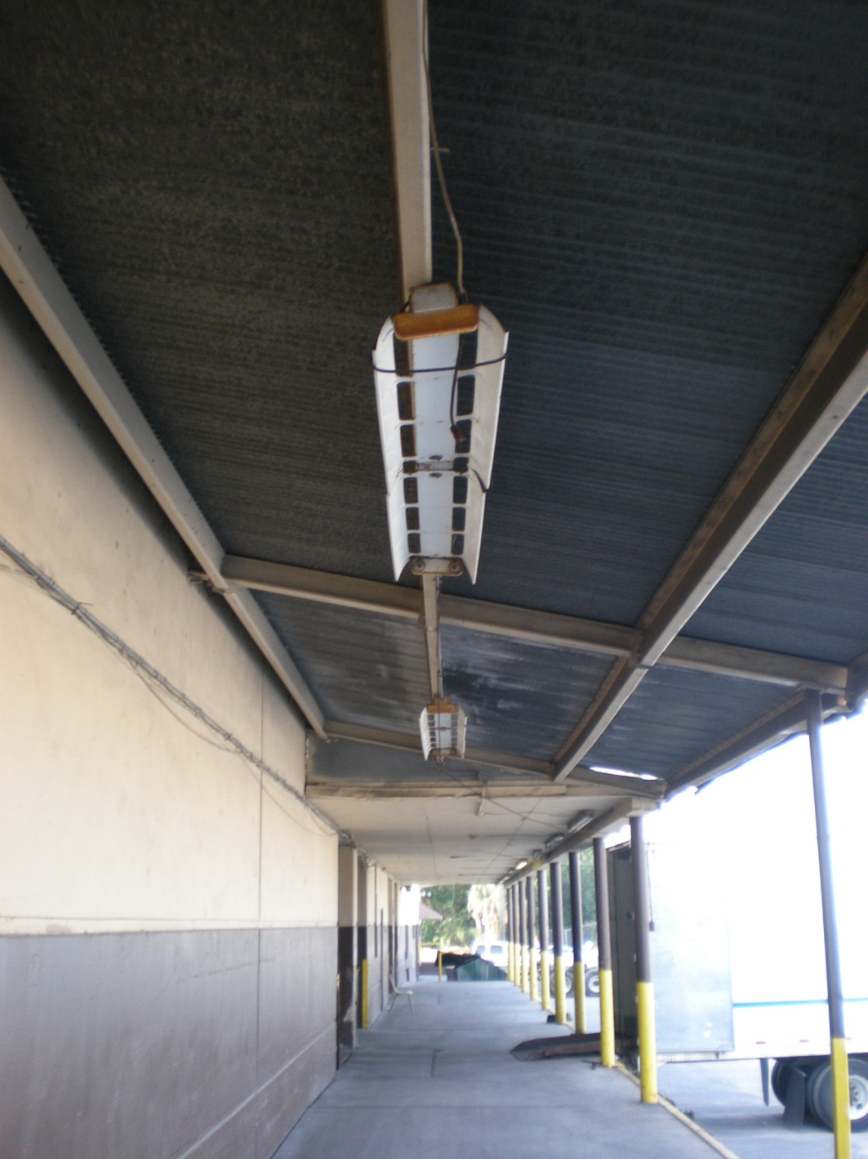

Slide 45
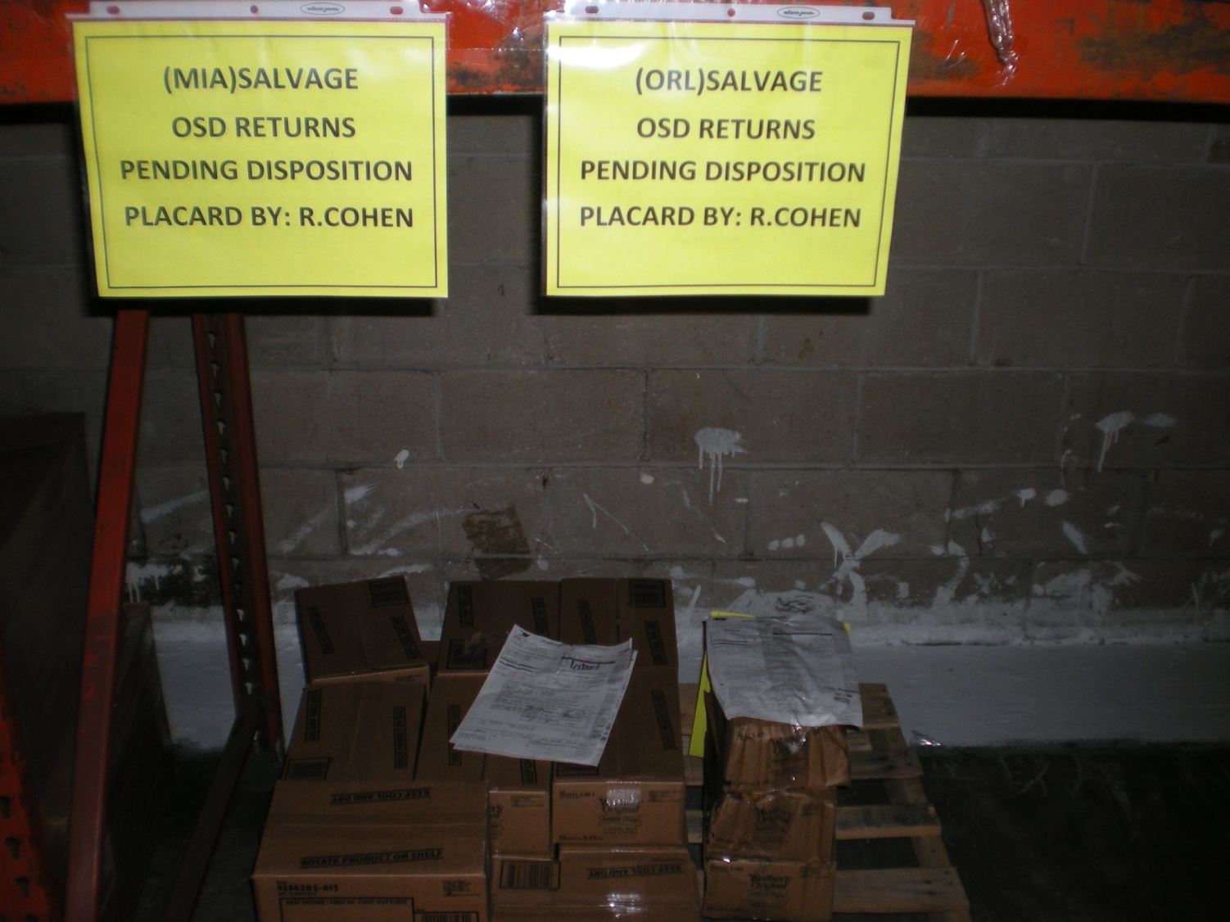
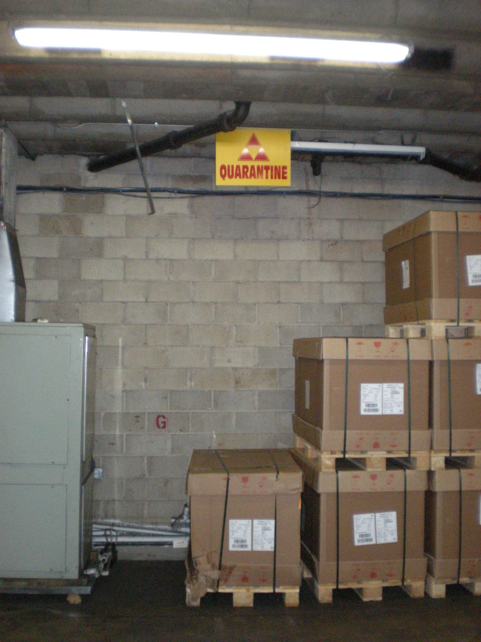
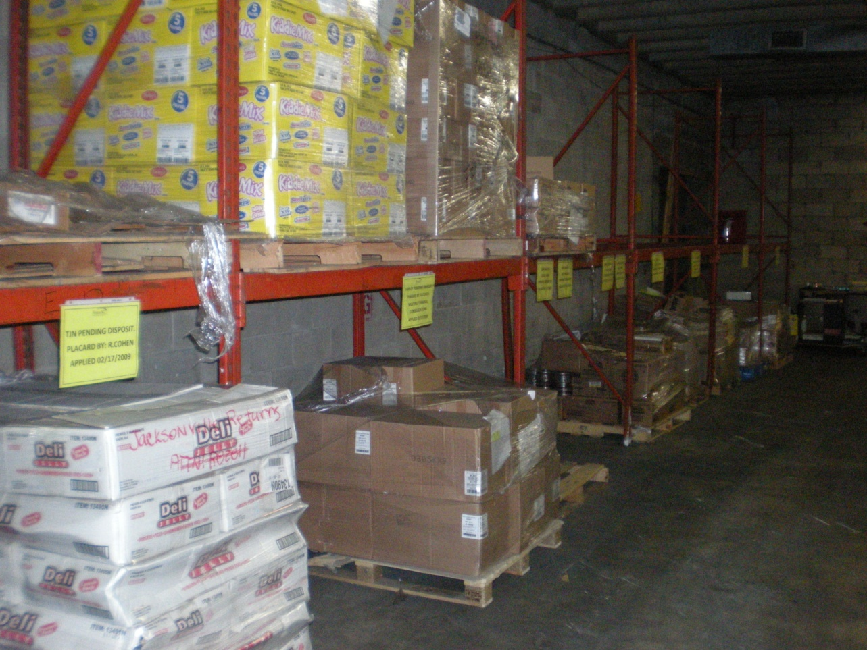

Slide 46
LEAN
A phenomenon that seeks to "maximize the work effort of a company's number one resource, the People.“
Lean is "a way of thinking" to adapt to change, eliminate waste, and continuously improve. There are a number of tools and techniques, used in concert, to achieve maximizing the effort of the workforce and to operate as a "lean" company

