Slide 1


ERP & WMS
Scott Lane
Penser Supply Chain Inc.
29 Oct 08

Slide 2
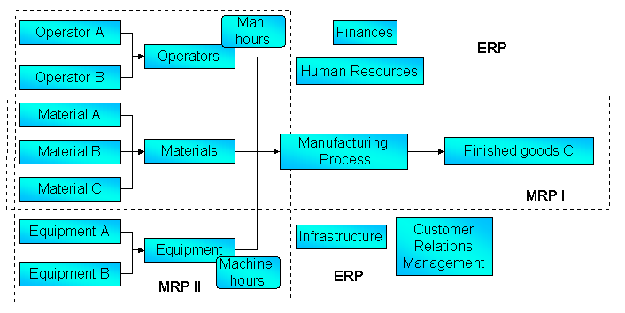
What is ERP?
“Integration of departments & functions into a single system”
Grew out of MRP

Slide 3
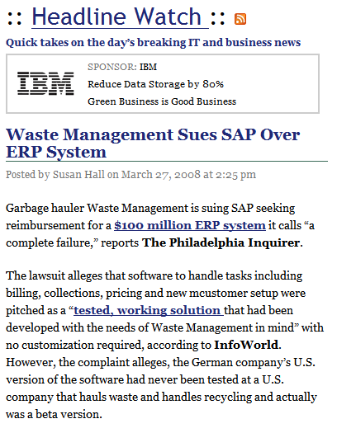

Failed Projects

Slide 4
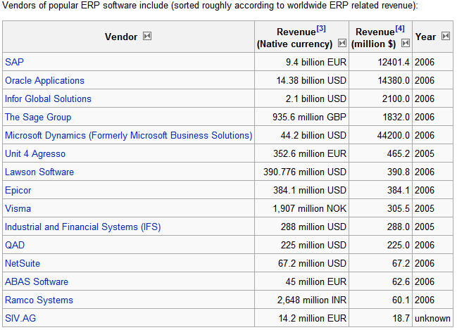
Myth or Reality?
How do you build software that serves all departments and functions?
http://en.wikipedia.org/wiki/List_of_ERP_vendors

Slide 5

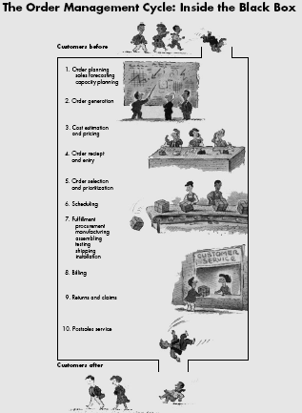

July – August 1992
1. Order planning sales forecasting capacity planning
2. Order
Generation
3. Cost estimation & pricing
4. Order receipt and entry
5. Order selection & prioritization
6. Scheduling
7. Fulfillment (mfg)
How many people touch it, change it, or re-key it?
8. Billing
9. Returns & Claims
10. Post-sales Service
Delays
Errors
Lost orders

Slide 6
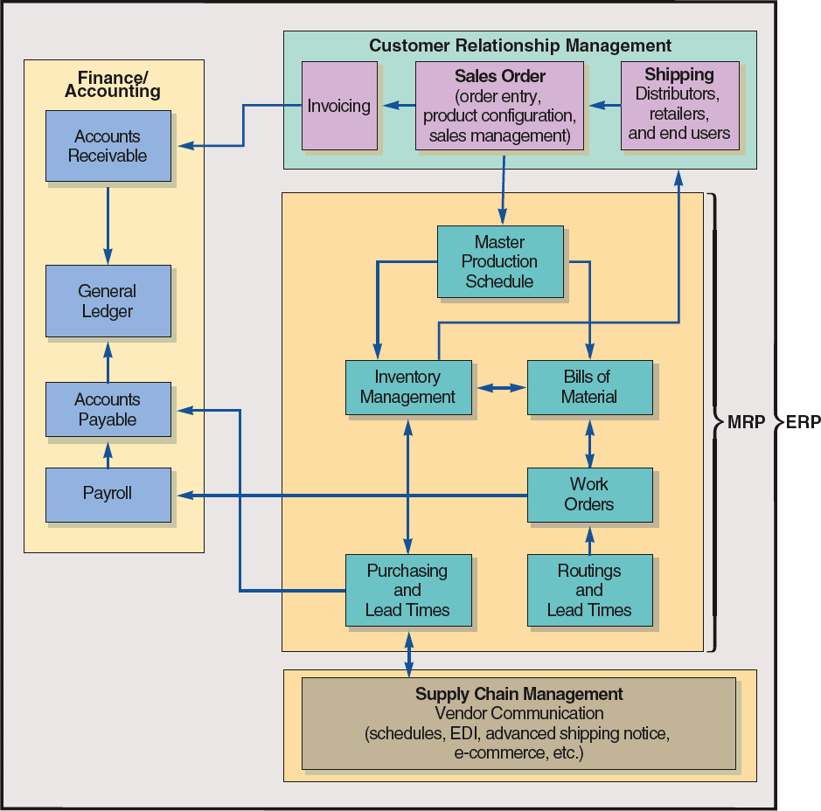
Major Components of ERP
Finance
CRM
MRP (MFG)
SCM
HR

Slide 7
Customer Relationship Management
Finance/ Accounting
Invoicing
Sales
Order
Shipping
Accounts Receivable
Master Production Schedule
General Ledger
Inventory Management
Bill of Material
Purchasing
Work Orders
Accounts Payable
Supply Chain Management
Vendor Communication
Payroll
Warehouse
Management
Transportation Management

Slide 8
Why Endure the Pain of ERP
Integrate Financial data
Standardize Manufacturing process
Standardize HR

Slide 9
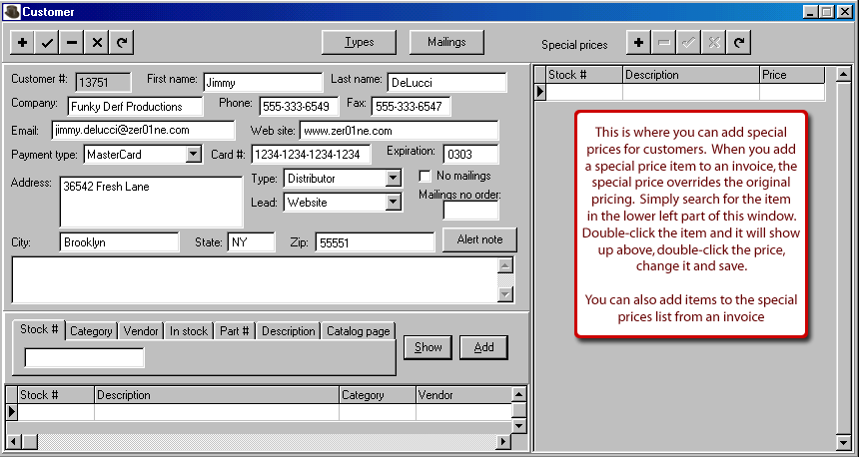

Customer Order (Address)

Slide 10


ERP = Data Management
Purchasing
Order
Management
Customer Relationship Management
Customer Profile
Inventory
Common
Database
Accounting
Shipping Profile
Manufacturing
Carrier Profile
Payroll
Item
Profile
Inventory
Transportation Management
Warehouse Management

Slide 11
Logistics
Measures & Goals
Information Systems Requirements
Process Designs
Organization Development
Customer Service & Order Processing
Inventory Planning & Management
Supply
Transportation
Warehousing
CS Policy
Forecasting
Supplier Service Policy
Network Design
Receiving
Satisfaction
Order Qty Engineering
Sourcing
Shipment Mgt
Putaway
Order Entry
Fill Rate Planning
Supplier Integration
Fleet Mgt
Storage
Order Processing
Control Policy
PO Processing
Carrier Mgt
Order Picking
Invoicing & Collections
Deployment
Buying & Payment
Freight Mgt
Shipping

Slide 12
WMS Scope
A Warehouse Management System’s primary mission is the management of
a warehouse’s resources, including space, labor, equipment, tasks, and material flow
WMS as a real time solution that utilizes
Radio Frequency, Voice Recognition, or Radio Frequency Identification

Slide 13
WMS Marketplace
The WMS market is highly fragmented with over 80 suppliers of that solution.
Manhattan
Red Prairie
Infor
SAP
Oracle
80 Other Vendors
Rev > $60 million

Slide 14
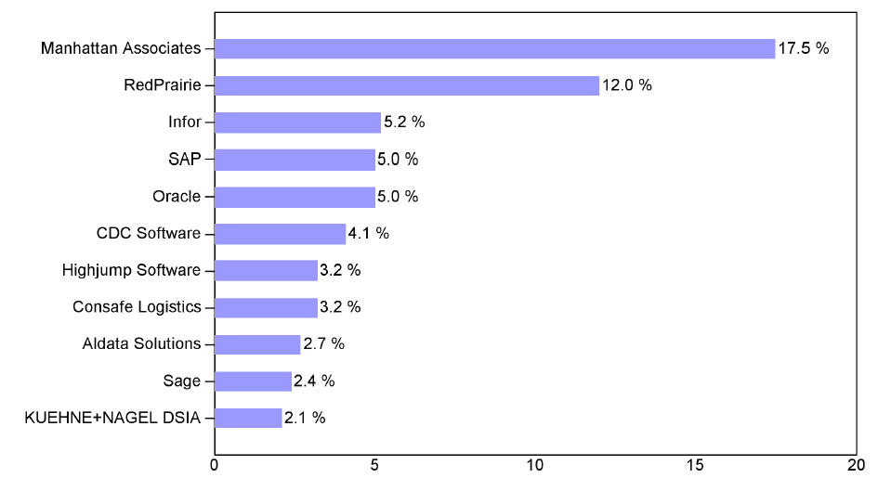
ARC’s Top Ten
Copyright 2008 © ARC Advisory Group • ARCweb.com

Slide 15
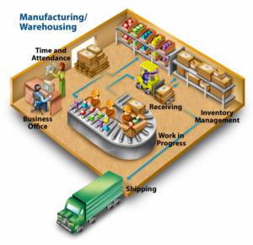
Major Warehouse Functions
Picking
Put-away
Receiving
Inventory
Shipping

Slide 16
Warehouse Operations
Tasks | Tasks | Tasks
Receiving | Storage/Inventory Tracking | Order Entry
Picking/Staging/Loading | Cross-docking | Return Processing
Packaging | Light Assembly/Kitting | Labeling/Packaging
Promotions | Breakbulk/Consolidation | Transportation
Import/Export | Proof –of – delivery | Tracing
Billing | Reporting | Planning

Slide 17
Warehouse Management
Crossdocking
Customer Profile
Receiving
Shipping
Shipping Profile
Common
Database
Inventory
Warehouse Task Management
Carrier Profile
Item
Profile
Billing
Labor
Management

Slide 18
World-class Warehousing Practices

Slide 19
Questions?

